Slide 1
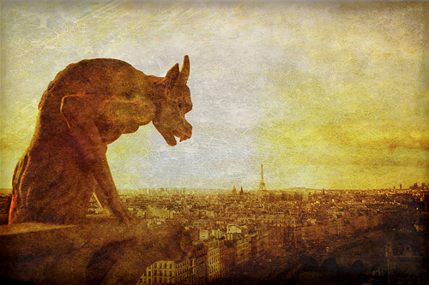
Perilous Times , Spiritual Warfare &
The Rise of Demonic Activity

Slide 2
By the pricking of my thumbs, Something wicked this way comes.
2nd Witch, Macbeth Act 4, Scene1

Slide 3
The Following are News Headlines
from Around the World and the USA.

Slide 4
U.S. post-Christian population soars in 2015
By Michael F. Haverluck, OneNewsNow.com September 28, 2015 6:47 am

Slide 5
Vatican to train army of exorcists to deal with rising number of ‘demonic possessions’ By HANNAH ROBERTS IN ROME FOR MAILONLINE

Slide 6
Catholic Church is forced to recruit more exorcists after the number of 'demonic possessions' in the Philippines triples.
By SIMON TOMLINSON FOR MAILONLINE

Slide 7
Exorcism Thriving in U.S., Say Experts
By: OLIVER.LIBAW ABCNEWS.COM

Slide 8
Satanic Temple unveils goat-headed statue in Detroit
By Cody Derespina
Published July 27, 2015 FoxNews.com

Slide 9
Satanic Temple Distributes Coloring Activity Books In Florida Schools.
Benjamin Fearnow September 16, 2014 2:41 PM

Slide 10
School Headmaster’s Creepy Claims About How ‘Charlie Charlie’ Demon Phenomenon is Impacting Kids.
Jun. 10, 2015 11:58am Billy Hallowell

Slide 11
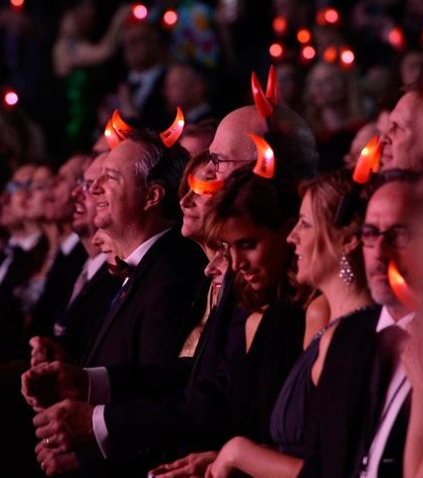
Did You Catch the ‘Satanic’ Religious Theme That Popped Up During the Grammys?
Feb. 9, 2015 11:05am Billy Hallowell

Slide 12
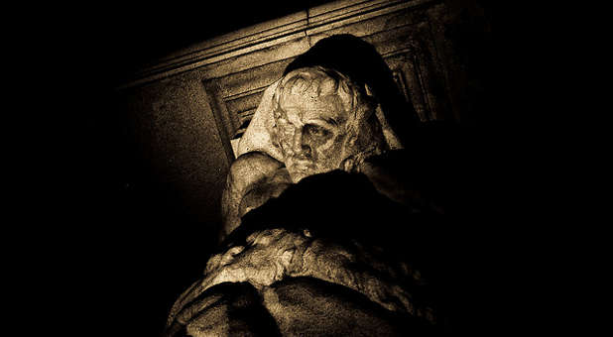
CHARISMANEWS
Breaking News. Spiritual Perspective
Wicked 'Supernatural' Gift Among 2014's Christmas Sell-Out Items
John J. Cannon 12\31\2014

Slide 13
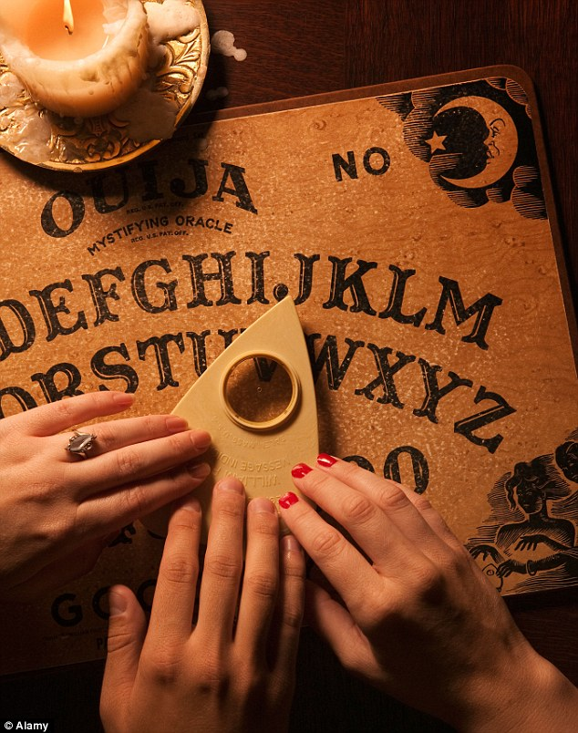
Sales of Ouija boards up 300% and threatening to become a Christmas 'must buy' despite warning from churchmen.
By NEIL TWEEDIE FOR THE DAILY MAIL PUBLISHED: 20:17 EST, 30 November 2014

Slide 14
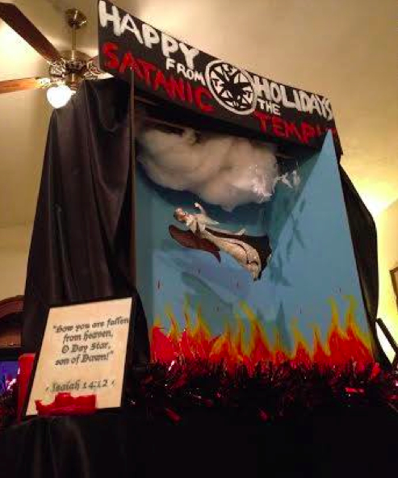
Satanists Want This ‘Grossly Offensive’ Devil-Themed Holiday Display Placed Near a Nativity in Florida’s State Capitol
Oct. 17, 2014 Billy Hallowell

Slide 15
Aleteia NEWS SPIRITUALITY LIFE
How Is our Culture Contributing to the Rise in Satanic and Occult Practices?
Susan E. Wills October 1st, 2014

Slide 16
ROBIN WILLIAMS ACKNOWLEDGED HE CHANNELED DEMONIC SPIRITS FOR COMEDIC POWER.
Geoffery Grider August 14th, 2014

Slide 17
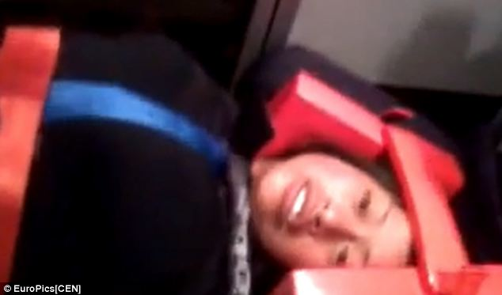
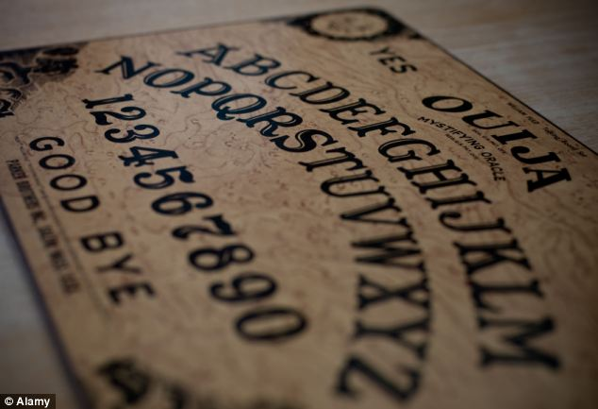
Three American friends hospitalized after becoming 'possessed' following Ouija board game in Mexican village.
By SOPHIE JANE EVANS
PUBLISHED: 08:05 EST, 23 June 2014

Slide 18
CHARISMANEWS
Breaking News. Spiritual Perspective
Satanists Demand Equal Time With Jesus as Antichrist Spirits Rise
12:30PM EST 12/13/2013 JENNIFER LECLAIRE

Slide 19
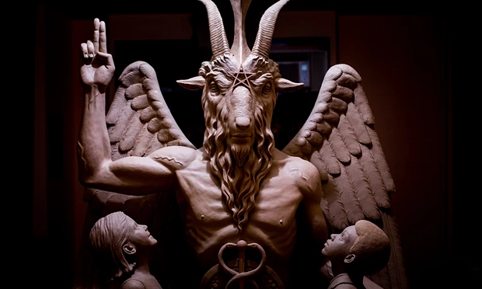
Tulsa World
Satanic statue planned for Oklahoma capitol to be unveiled at secret Detroit location
Associated Press: Monday July 13th, 2015

Slide 20
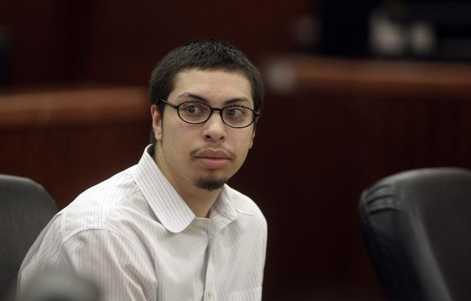
NYDailyNews.com / NY Daily News
Texas teen gets life in prison for ‘Satanic’ murder of 15-year-old girl
BY MEG WAGNER NEW YORK DAILY NEWS Updated: Friday, June 19, 2015

Slide 21
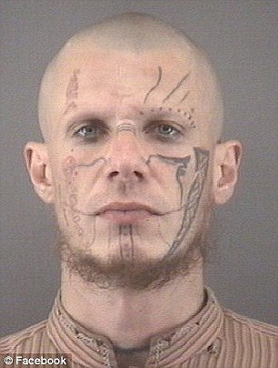
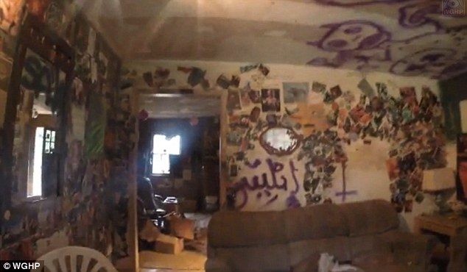
FOX8 TV- WGHP
First look inside Clemmons home of ‘devil worshipper’ accused of murder, sacrificing animals - Clemmons, NC
POSTED 4:10 PM, NOVEMBER 5, 2014, BY WEB STAFFAND WINSTON-SALEM JOURNAL

Slide 22
AL.com
Witches, pagans and Wiccans in Alabama: A growing culture and a struggle for acceptance
By Kathryn Jacoby on October 24, 2014

Slide 23
Natural News
America’s truth news bureau, read by 7 + million and growing
Fox network launching new TV series that glorifies Lucifer; marketed with pro-Satan tweets
Sunday, May 24, 2015 by: Ethan A. Huff, staff writer

Slide 24
Deadline/Hollywood
The Walking Dead’ Ratings: Season 5 Debut Shatters Cable Records As 17.3M Watch
by Dominic Patten October 13, 2014 1:31pm

Slide 25
‘Fear the Walking Dead’ Season 1 Smashes Cable Ratings Record TV
By Linda Ge on October 9, 2015

Slide 26
People
What Theresa Caputo Wants You to Know About Talking to Dead People
BY RENNIE DYBALL 08/01/2014
Long Island Medium

Slide 27
NEW YORK POST
Syfi Series ‘Childhoods End’ spawns awesome satanic alien
By Eric Hegedus December 15, 2015
These awesome aliens and their leader KARELLEN bring PEACE, EQUITY, JUSTICE to the world. They eliminate HUNGER, WAR, POLLUTION, GOVERNMENTS,*
Brings peace between the Arabs and Jews.
They are able to resurrect dead loved ones.
Brings in one world gov’t (World Federation)
Ends hunger, poverty, disease, crime, extends life span (basically eliminates the curse of sin and death placed on earth by God)
Ushers in the ‘Golden Age of Man’
*Not in original book –written by Authur C. Clark

Slide 28
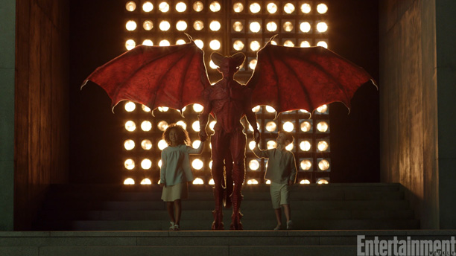
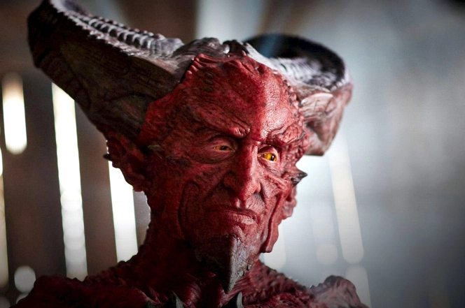
The Wonderful and Compassionate Leader of these Aliens that bring heaven to earth
Is KARELLEN. He is greeted by children as he makes his appearance to humanity for the first time after bringing peace to the world
KARELLEN

Slide 29
Vox Explainers
"Charlie, Charlie, are you there?" Why teens are summoning demons, explained.
Updated by Phil Edwards on June 5, 2015

Slide 30
The two US 12-year-olds obsessed with online ghost stories 'who lured classmate into woods and stabbed her 19 times' to prove 'Slender Man' myth was real By MICHAEL ZENNIE and ASSOCIATED PRESS REPORTER
PUBLISHED: 12:03 EST, 2 June 2014

Slide 31
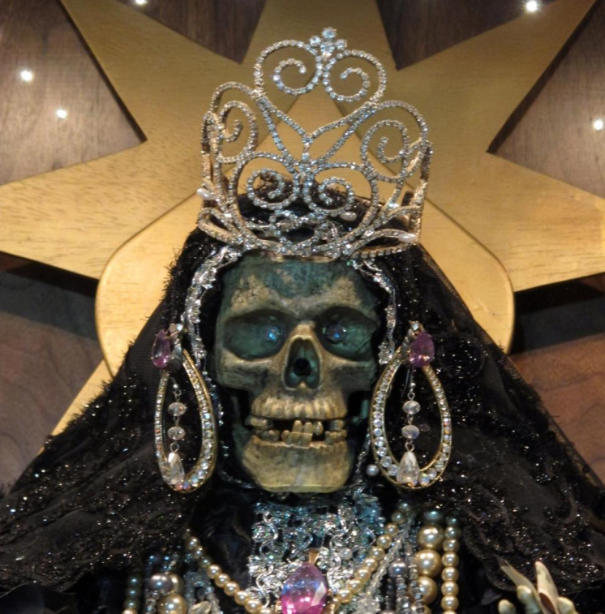
DAILEY NEWS
La Santa Muerte, skeleton saint popular among those in drug trade, gaining popularity in U.S.
THE ASSOCIATED PRESS Monday, March 4, 2013,
Notes:
Popular in Mexico, and sometimes linked to the illicit drug trade, the skeleton saint known as La Santa Muerte in recent years has found a robust and diverse following north of the border: immigrant small business owners, artists, gay activists and the poor, among others — many of them non-Latinos and not all involved with organized religion.

Slide 32
Newsmax
independent american
Franklin Graham Rips US 'Fascination and Obsession With Death'
By Jason Devaney | Monday, 12 Jan 2015

Slide 33
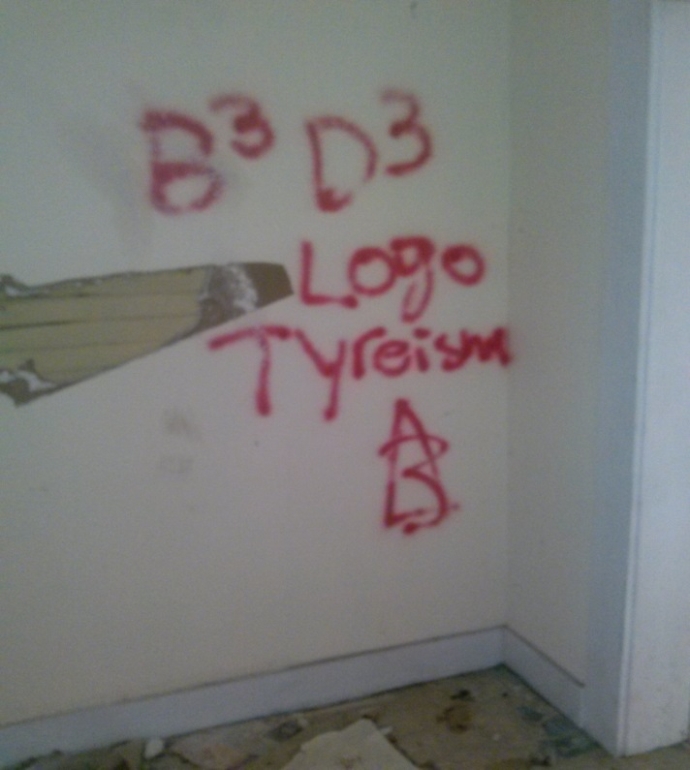
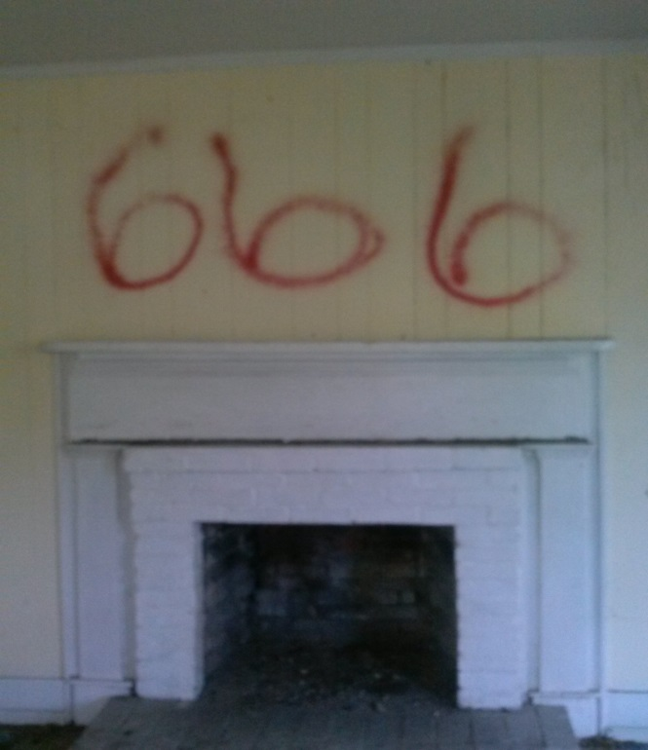
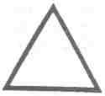
Abandoned House - Tallassee, AL
Thaumaturgic Triangle Used for magical purposes in casting of spells and the summoning of demons. Found near ritual sites. believed to be the door through which the demon will be called.
Tyreism ?? =Tritheism: The belief in the existence of three deities. This is one form of polytheism.

Slide 34
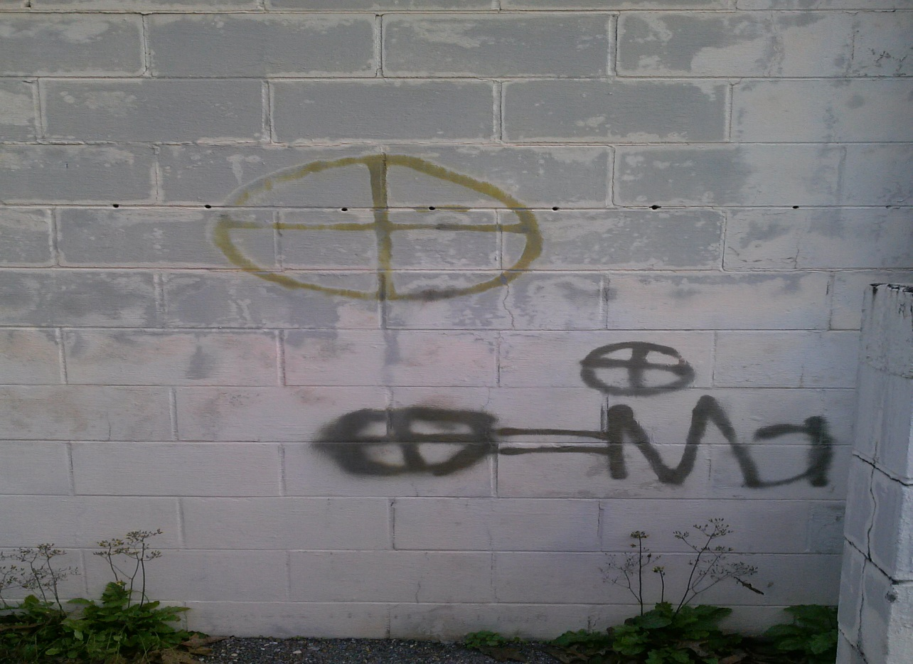
Tallassee, AL – 1\6\16
CIRCLE (Quartered): The sacred circle filled with a cross, four equal lines pointing from the center to the spirits of the north, east, south, and west -- or to the basic element: earth, water, air (or wind), and fire. In Native American traditions, it forms the basic pattern of the MEDICINE WHEEL and plays a vital part in major spiritual rituals. Many contemporary pagans consider it their main symbol for transmitting the energy of the goddess.

Slide 35
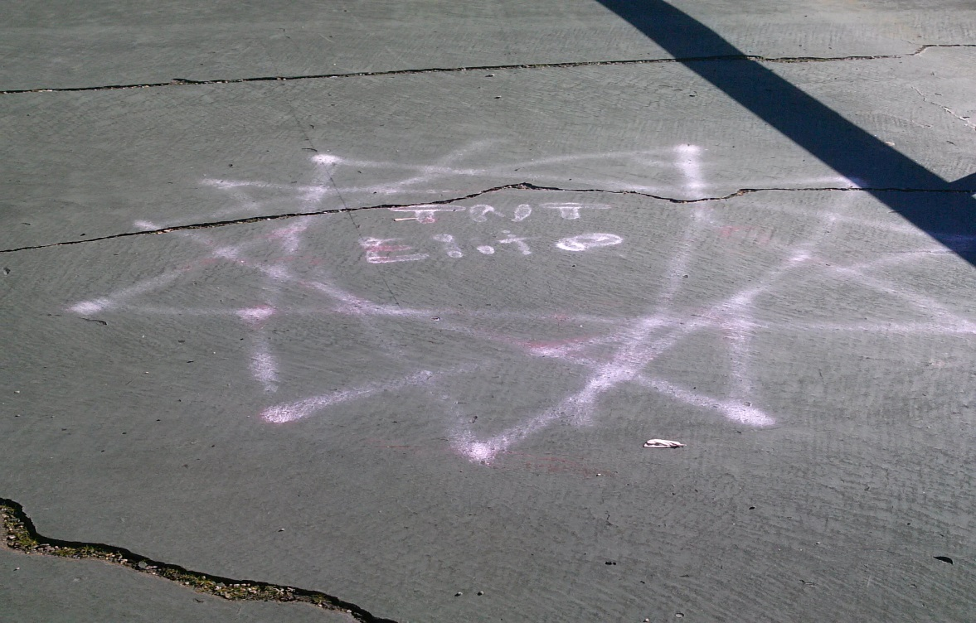
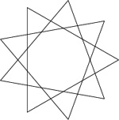
Tallassee, AL – 1\6\16
enneagram - said to represent the underlying geometry of the universe. well known emblem of the Baha’i faith, symbolizing the value of the word baha, “glory.” which emphasizes the spiritual unity of all humankind.

Slide 36
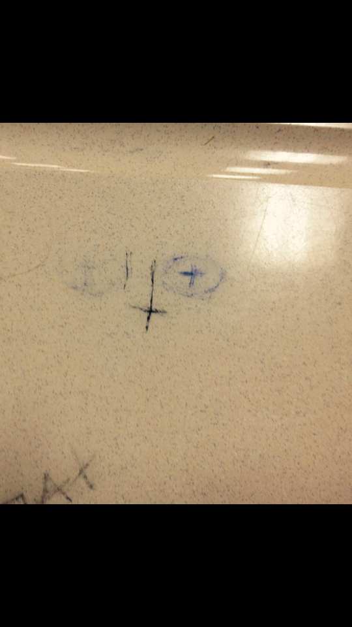
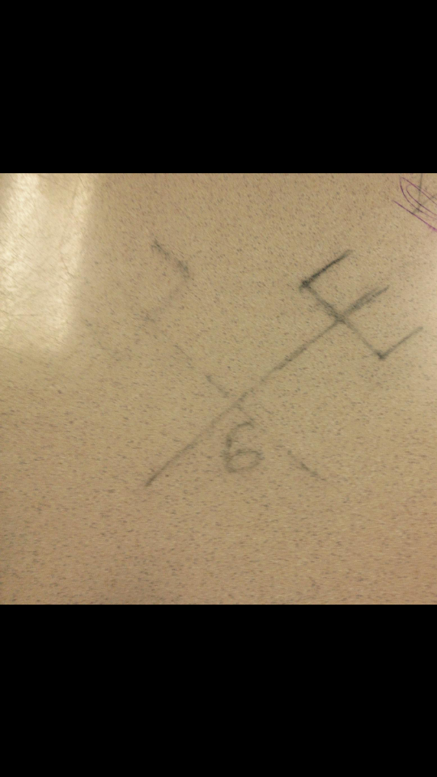
Desk, Tallassee, AL – January, 2016

Slide 37
“There are two equal and opposite errors into which our race can fall about the devils. One is to disbelieve in their existence. The other is to believe, and to feel an excessive and unhealthy interest in them.” – C.S. Lewis

Slide 38
UFO’s & Aliens

Slide 39
CP World
Vatican Astronomer Says Alien Life Will Be Discovered, But Will Not Prove or Disprove God.
By Stoyan Zaimov , Christian Post Reporter September 22, 2014

Slide 40
VATICAN PREPARING STATEMENT ON EXTRATERRESTRIAL LIFE
WRITTEN BY DR MICHAEL SALLA ON JULY 23, 2014.
The Vatican’s scientific interest in extraterrestrial life was publicly revealed for the first time in May 2008 when the head of the Vatican Observatory, Fr Gabriel Funes, also a Jesuit, gave an interview to the Vatican newspaper, L’Osservatore Romano. Funes made a series of startling statements about how extraterrestrial life is likely to be more ethically evolved than humans, and can be welcomed as brothers.

Slide 41
NASA Follows Vatican’s Footsteps, Holds Conference to Prepare the World for Extraterrestrial Life
by EDITOR on SEPTEMBER 24, 2014

Slide 42
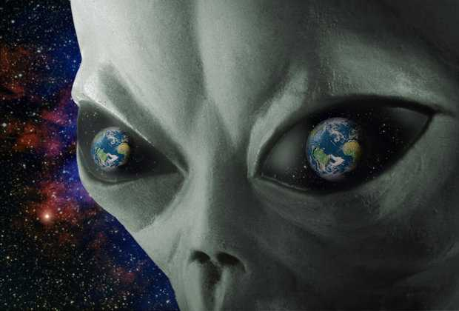
NASA CONFIRMS EXTRATERRESTRIAL LIFE DOES EXIST ON OTHER PLANETS

Slide 43
www.nasa.gov
July 14, 2014
Finding Life Beyond Earth is Within Reach

Slide 44
Aliens may have visited: Shock Hillary Clinton claim as she vows to open 'UFO cover up‘
"I think we may have been visited already. We don’t know for sure.” – Hillary Clinton
By JON AUSTIN PUBLISHED: 12:33, Mon, Jan 4, 2016

Slide 45
"We all know that UFOs are real. All we need to ask is where do they come from, and what do they want?"
Apollo 14 Astronaut Capt. Edgar Mitchell

Slide 46
Ephesians 6:12
For we wrestle not against flesh and blood, but against principalities, against powers, against the rulers of the darkness of this world, against spiritual wickedness in high places.
“The believer’s enemies are the demonic hosts of Satan, always assembled for mortal combat” Charles Caldwell Ryrie – Commentary, Ryrie Study Bible

Slide 47
Matthew 16:2-3
2He answered and said unto them, When it is evening, ye say, It will be fair weather: for the sky is red.
3And in the morning, It will be foul weather to day: for the sky is red and lowring. O ye hypocrites, ye can discern the face of the sky; but can ye not discern the signs of the times?

Slide 48
Pew Research
Religion & Public Life
MAY 12, 2015
America’s Changing Religious Landscape
Christians Decline Sharply as Share of Population; Unaffiliated and Other Faiths Continue to Grow

Slide 49
The Paganizing of America
I Timothy 4:1
1Now the Spirit speaketh expressly, that in the latter times some shall depart from the faith, giving heed to seducing spirits, and doctrines of devils;

Slide 50
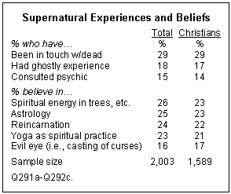
2007 Pew Research Poll- US religious Landscape Survey

Slide 51
42% of Americans believe in ghosts (especially younger people), 36% each believe in creationism and UFOs, 29% believe in astrology, 26% believe in witches and 24% believe in reincarnation – that they were once another person.-Harris Poll Dec.2013
The 2001 American Religious Identification Survey (ARIS), which involved 50,000 participants, reported that the number of participants in the survey identifying themselves as deists grew at the rate of 717% between 1990 and 2001.-2oo1 American Religious Identification Survey
The American Religious Identification Survey gives Wicca an average annual growth of 143% for the period 1990 to 2001 (from 8,000 to 134,000 – U.S. data / similar for Canada & Australia) – 2001 American Religious Identification Survey
More US Christians Mix In ‘Eastern New Age Beliefs- USA Today Article. Dec. 10th, 2009“
“Elements of Eastern faiths and New Age thinking have been widely adopted by 65% of U.S. adults, including many who call themselves Protestants and Catholics, according to a survey by the Pew Forum on Religion & Public Life released Wednesday.”

Slide 52
The stage has been set

Slide 53
I. Occultism in the Old Testament &
New Testament
{OT}
Exodus 7:10-11, 22, 8:7, 18-19, 9:11
I Samuel 28:7-8, 11, 15, 16-19
I Chronicles 10:13
II Kings 16:2-4
II Kings 21: 1-2, 6
Joshua 13:22

Slide 54
Sorcerers = Strong’s H3784 kâshaph kaw-shaf' A primitive root; properly to whisper a spell, that is, to inchant or practise magic: - sorcerer, (use) witch (-craft).
Familiar spirit = obe
From the same as H1 (apparently through the idea of prattling a father’s name); properly a mumble, that is, a water skin (from its hollow sound); hence a necromancer (ventriloquist, as from a jar): - bottle, familiar spirit –a demon
Familiar Spirit= Strong’s H178 ‘obe’ hence a necromancer, The Hebrew word is used to denote a necromancer, a conjuror; particularly one who was supposed to have power to call up the dead- Barnes ;
A medium that is controlled by a demon –Fuchtenbaum-Demonology
The Doctrine Of Demons
Soothsayer = Strong’s H7080 qâsam - kaw-sam' A primitive root; properly to distribute, that is, determine by lot or magical scroll; by implication to divine: - divine (-r, -ation), prudent, soothsayer, use [divination].

Slide 55
{NT}
Acts 8:9-11
Acts 13:6, 8-11

Slide 56
II. Gods Prohibition against Consulting
Spirits & Occultism
Exodus 22:18
Leviticus 19:26, 31, 20:27
Leviticus 20:6
Deuteronomy 18:9-14
I Samuel 15:23
Isaiah 8:19
Jeremiah 29:8-9
Micah 5:12
Acts 19:18-20
Galatians 5:19-20

Slide 57
Divination = Strong’s H7081 qesem- keh'-sem
From H7080; a lot; also divination (including its fee), oracle: - (reward of) divination, divine sentence, witchcraft
{i.e. fortune telling by magical means}
Observer of times = Strong’s H6049 ‛ânan - aw-nan'
A primitive root; to cover; used only as denominative from H6051, to cloud over; figuratively to act covertly, that is, practise magic: - X bring, enchanter, Meonemin, observe (-r of) times, soothsayer, sorcerer.
Enchanter = Strong’s H5172 nâchash - naw-khash'A primitive root; properly to hiss, that is, whisper a (magic) spell; generally to prognosticate: - X certainly, divine, enchanter, (use) X enchantment, learn by experience, X indeed, diligently observe.
{i.e. a magician who puts others under a demonic spell or under demonic control}
Witch =Strong’s H3784 kâshaph - kaw-shaf'
A primitive root; properly to whisper a spell, that is, to inchant or practise magic: - sorcerer, (use) witch (-craft).

Slide 58
Charmer = Strong’s H2266 châbar - khaw-bar'
A primitive root; to join (literally or figuratively); specifically (by means of spells) to fascinate: - charm (-er), be compact,
couple (together), have fellowship with, heap up, join (self, together), league.
{i.e. one who practices magic miracles, incantations and hypnotism}
Necromancer = Strong’s H1875 dârash - daw-rash'
A primitive root; properly to tread or frequent; usually to follow (for pursuit or search); by implication to seek or ask; specifically to worship: mûth
mooth
A primitive root; to die (literally or figuratively); causatively to kill: - X at all, X crying, (be) dead (body, man, one), (put to, worthy of) death, destroy (-er), (cause to, be like to, must) die, kill, necro [-mancer],
{i.e. a medium that consults the dead}

Slide 59
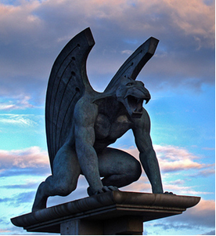
III. Angels & Demons
“The acknowledgement of evil spirits is characteristic of Christianity.” –Theological Essays pg.32-34

Slide 60
Angels are created beings. There is an important distinction that must be made between the Angels of God (YHVH) who are his messengers and serve Him, and the angels that fell with Lucifer\Satan.
Angels (Those that did not fall with Lucifer\Satan) are the messengers of God and spiritual beings that do the will of God. They have always appeared as men and are ministering spirits to the heirs of salvation. They are mentioned in the Bible from Genesis to Revelation.

Slide 61
In the Bible, Angels:
1. Were never said to enter into anyone.
2. Have no affection for bodies, either as habitations or vehicles of
action.
3. Have no inclination or favoring for tombs and monuments of the
dead.
On the other hand, demons:
1. Have entered into human bodies and into the bodies of inferior creatures.
2. Demonstrate a peculiar affection for human bodies and seem to desire them
both as vehicles of action and as places of habitation.
3. Demonstrate a peculiar fondness for graveyards, tombs, and
sepulchers.

Slide 62
ANGELS THAT DO THE WILL OF GOD & MANIFEST IN HUMAN FORM
Genesis 19:1
Genesis 19:10-11
Genesis 19:13
Matthew 28:2
Mark 16:5
John 20:12
Hebrews 1: 7, 13-14
Hebrews 13:2

Slide 63
Angels in the Book of Revelation
Gave revelation to John {Rev. 1:1,2}
Worshipped God {Rev. 5:11,12}
Help the servants of God {Rev. 7: 2,3}
Support preaching of the Gospel {Rev. 14:6,7)
Brings Gods judgment on earth {Rev. ch. 8,9 and 11.}

Slide 64
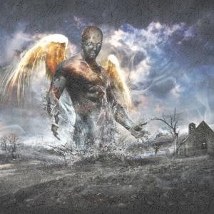
DEMONS- ORIGINS
{The existence of demons is mentioned by every New Testament writer except the author of Hebrews, while not mentioning demons he did mention Satan the prince of demons. (Heb.2:14}
All the Pagan authors of note, whose works have survived the wreck of ages, affirm the opinion that demons were the spirits or ghosts of dead men. From Hesiod down to the more polished Celsus, their historians, poets, and philosophers occasionally express this opinion.-Alexander Campbell, Demonology (pg.3)

Slide 65
Biblical Evidence against the view that demons are the spirits of dead men or that ‘ghosts’ are spirits of the dead that come back to haunt a place or person.
Ecclesiastes 12:7Then shall the dust return to the earth as it was: and the spirit shall return unto God who gave it.
Job 7:9-10 As the cloud is consumed and vanisheth away: so he that goeth down to the grave shall come up no more. 10He shall return no more to his house, neither shall his place know him any more.

Slide 66
DEMONS AS THE SPIRITS OF FALLEN ANGELS
Holds that the ‘Sons of God’ (ben ha elohiym) are indeed angels that fell with Lucifer\Satan and also committed a further transgression against God by assaulting the divine bloodline and attempting to stop the coming of the Messiah (Gen. 3:15)
Genesis 6:1 And it came to pass, when men began to multiply on the face of the earth, and daughters were born unto them,
Genesis 6:2That the sons of God saw the daughters of men that they were fair; and they took them wives of all which they chose.
Genesis 6:4There were giants* in the earth in those days; and also after that, when the sons of God* came in unto the daughters of men, and they bare children to them, the same became mighty men which were of old, men of renown.
Genesis 6:4 - When = Hebrew word ‘asher’ means: because, in order that, for as much,
from whence

Slide 67
When = ash-er‘ A primitive relative pronoun (of every gender and number); who, which, what, that; also (as adverb and conjunction) when, where, how, because, in order that, etc.: - X after, X alike, as (soon as), because, X every, for, + forasmuch, + from whence, + how (-soever), X if, (so) that ([thing] which, wherein), X though, + until, + whatsoever, when, where (+ -as, -in, -of, -on, -soever, -with), which, whilst, + whither (-soever), who (-m, -soever, -se). As it is indeclinable, it is often accompanied by the personal pronoun expletively, used to show the connection.
Giants= Strong’s H5303 n^{e}phı̂yl n^{e}phil nef-eel', nef-eel' From H5307; properly, a feller, that is, a bully or tyrant: - giant.
Sons of God = ben ha elohiym
Strong’s H1121 bên – bane From H1129; a son (as a builder of the family name),
Strong’s H430 ĕlôhı̂ym - el-o-heem'Plural of H433; gods in the ordinary sense; but specifically used (in the plural thus, especially with the article) of the supreme God; occasionally applied by way of deference to magistrates; and sometimes as a superlative: - angels, X exceeding, God (gods) (-dess, -ly), X (very) great, judges, X mighty.

Slide 68
The expression ‘Son of God’ (ben ha elohiym) is used in Job 1:6; 2:1; 38:7 Psalms 29:1; 89:6 and Daniel 3:25 as indicative of angels and there is no reason or scriptural authority for taking the expression to mean something different in Genesis 6: 2. Their sin is also made clear in the very same verse. The offspring of this abominable union between fallen angels and the daughters of men are the ‘Nephilim’ translated as giants Gen. 6:4.

Slide 69
Now it is the belief of not a few that it is the disembodied spirits of these fallen angels that mingled with the daughters of men that are the demons. However I believe that this is also an incorrect conclusion in that the spirits of these fallen angels are now held in captivity and not free to roam the earth and do the works of Satan.
2Peter 2:4 For if God spared not the angels that sinned, (sin of Gen. 6:2) but cast
them down to hell, and delivered them into chains of darkness, to be reserved unto
judgment.
Jude 1:6 And the angels which kept not their first estate, but left their own habitation, he hath reserved in everlasting chains under darkness unto the judgment of the great day.
Jude 1:7 Even as Sodom and Gomorrha, and the cities about them in like manner, giving themselves over to fornication, and going after strange flesh, are set forth for an example, suffering the vengeance of eternal fire.

Slide 70
There are two confinements for the one-third of angels that fell with Satan. (Rev. 12:4, 9) These angels are confined temporarily in the bottomless pit (abyss) to be released for the purpose of performing specific judgments during the Great Tribulation. (Rev. 9:1-11; 13-21)
The angels that committed the sin of Gen 6:2 producing the Nephilim are “delivered into chains of darkness, to be reserved to judgment” Their confinement is permanent in hell (tartarus*) separate from those confined in the bottomless pit.
(2 Peter 2:4, Jude 1:6)
Strong’s G5020 tartaroō - tar-tar-o'-o From Tartaros̄ (the deepest abyss of Hades); to incarcerate in eternal torment: - cast down to hell.
NOTE: Those who disagree that angels mingled with the daughters of men reference Matthew 22:30 For in the resurrection they neither marry, nor are given in marriage, but are as the angels of God in heaven.
I think a distinctive must be made between between the physical body and the resurrection body and the angels OF GOD in heaven and those that left their first estate and perhaps in this realm took on flesh.

Slide 71
DEMONS AS THE DISEMBODIES SPIRITS OF THE NEPHILIM
Demon’s are the disembodied spirits of the Nephilim, the offspring and abomination of the intermingling of the Sons of God with the daughters of men. The Nephilim are part angelic and part human and an abomination to the order of creation of the Lord. While this is a supposition I believe this is the most likely origin of demons. Their spirits neither fully angelic nor fully human. They did evil while upon this earth and it is their spirits that are the demons. Their spirits lost to heaven and not yet sentenced to Hell.
The Bible does not speak of the origin of the demons specifically. However regardless of the origin of demons we do know that they do exist and they do influence, harass, and possess humans and animals. We know this because Jesus himself cast out many demons. Jesus also gave power to the apostle’s and disciple’s to cast out demons as well.

Slide 72
DEMON CHARACTERICS
Have Personal Names can Communicate, have supernatural strength
Luke 8:27-30
27And when he went forth to land, there met him out of the city a certain man,
which had devils long time, and ware no clothes, neither abode in any house, but in
the tombs.
28When he saw Jesus, he cried out, and fell down before him, and with a loud voice
said, What have I to do with thee, Jesus, thou Son of God most high? I beseech thee,
torment me not.
29(For he had commanded the unclean spirit to come out of the man. For
oftentimes it had caught him: and he was kept bound with chains and in fetters; and
he brake the bands, and was driven of the devil into the wilderness.)
30And Jesus asked him, saying, What is thy name? And he said, Legion: because
many devils were entered into him

Slide 73
Have Intelligence:
Mark 1: 23-24
23And there was in their synagogue a man with an unclean spirit; and he cried out,
24Saying, Let us alone; what have we to do with thee, thou Jesus of Nazareth? art
thou come to destroy us? I know thee who thou art, the Holy One of God.
Have Emotions:
Luke 8:28
28When he saw Jesus, he cried out, and fell down before him, and with a loud voice said, What have I to do with thee, Jesus, thou Son of God most high? I beseech thee, torment me not.

Slide 74
Have Will:
Mark 1: 25-27
25And Jesus rebuked him, saying, Hold thy peace, and come out of him.
26And when the unclean spirit had torn him, and cried with a loud voice, he came
out of him
27And they were all amazed, insomuch that they questioned among themselves, saying, What thing is this? what new doctrine is this? for with authority commandeth he even the unclean spirits, and they do obey him.

Slide 75
Seek to Physically\Mentally Control Human Beings:
Luke 8:27-30 (causing mental derangement, insanity, social mania)
27And when he went forth to land, there met him out of the city a certain man, which had devils
long time, and ware no clothes, neither abode in any house, but in the tombs.
28When he saw Jesus, he cried out, and fell down before him, and with a loud voice said, What
have I to do with thee, Jesus, thou Son of God most high? I beseech thee, torment me not.
29(For he had commanded the unclean spirit to come out of the man. For oftentimes it had
caught him: and he was kept bound with chains and in fetters; and he brake the bands, and was
driven of the devil into the wilderness.)
Mark 9: 17-18, 22
17And one of the multitude answered and said, Master, I have brought unto thee my son, which
hath a dumb spirit;
18And wheresoever he taketh him, he teareth him: and he foameth, and gnasheth with his teeth,
and pineth away: and I spake to thy disciples that they should cast him out; and they could not.
22And ofttimes it hath cast him into the fire, and into the waters, to destroy him: but if thou
canst do any thing, have compassion on us, and help us.

Slide 76
Cause Physical Disabilities
Matthew 9:32-33
32As they went out, behold, they brought to him a dumb man possessed with a devil.
33And when the devil was cast out, the dumb spake: and the multitudes marvelled,
saying, It was never so seen in Israel.
Luke 13:11
11And, behold, there was a woman which had a spirit of infirmity eighteen years, and was bowed together, and could in no wise lift up herself
Matthew 17:15-18
15Lord, have mercy on my son: for he is lunatick, and sore vexed: for ofttimes he falleth into the
fire, and oft into the water.
16And I brought him to thy disciples, and they could not cure him.
17Then Jesus answered and said, O faithless and perverse generation, how long shall I be with
you? how long shall I suffer you? bring him hither to me.
18And Jesus rebuked the devil; and he departed out of him: and the child was cured from that
very hour.

Slide 77
Receive Power from Sin
I Corinthians 7:5
5Defraud ye not one the other, except it be with consent for a time, that ye may give yourselves
to fasting and prayer; and come together again, that Satan tempt you not for your incontinency.
Incontinency = lack of self restraint
II Corinthians 4:4
4In whom the god of this world hath blinded the minds of them which believe not, lest the light
of the glorious gospel of Christ, who is the image of God, should shine unto them.
Demons Different from man made idols
I Corinthians 10:19-20
19What say I then? that the idol is any thing, or that which is offered in sacrifice to idols is any
thing?
20But I say, that the things which the Gentiles sacrifice, they sacrifice to devils, and not to God:
and I would not that ye should have fellowship with devils.

Slide 78
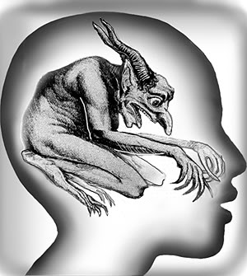
Demon Possession Distinct from Sickness and Diseases
Matthew 4:24
24And his fame went throughout all Syria: and they brought unto him all sick
people that were taken with divers diseases and torments, and those which were
possessed with devils, and those which were lunatick, and those that had the palsy;
and he healed them.
Mark 1:32
32And at even, when the sun did set, they brought unto him all that were diseased, and them that were possessed with devils.

Slide 79
Future Activities of Demons
Demonic activity abounds in countries with pagan roots beliefs and influences.
This is why demonic activity has been well known in the third world countries
of Africa, Indonesia, South America, and also in industrialized countries that
are pagan or Godless such as China.
As the influence of the True Blood Bought Born Again Church diminishes in
America and the work and restraint of the Holy Spirit is weakened by churches
that have a Christless Christianity and have lost their way:( 2Timothy 3:5
Having a form of godliness, but denying the Power thereof: from such turn
away.) The works of Satan and his demons will increase, including the
following:

Slide 80
Spreading False Doctrine in the Church.
I Timothy 4:1-3
1Now the Spirit speaketh expressly, that in the latter times some shall depart
from the faith, giving heed to seducing spirits, and doctrines of devils;
2Speaking lies in hypocrisy; having their conscience seared with a hot iron;
3Forbidding to marry, and commanding to abstain from meats, which God hath
created to be received with thanksgiving of them which believe and know the
truth.

Slide 81
Continued and Increased Worship of Satan and Demons in the Coming Perilous Times and Tribulation
1Corinthians 10:20 But I say, that the things which the Gentiles sacrifice, they
sacrifice to devils, and not to God: and I would not that ye should have fellowship
with devils.
Revelation 9:20And the rest of the men which were not killed by these plagues yet
repented not of the works of their hands, that they should not worship devils, and
idols of gold, and silver, and brass, and stone, and of wood: which neither can see,
nor hear, nor walk:
Perform miracles and deceptions.
Revelation 16:13-14 13And I saw three unclean spirits like frogs come out of the mouth of the dragon, and out of the mouth of the beast, and out of the mouth of the false prophet.
14 For they are the spirits of devils, working miracles, which go forth unto the kings of the earth and of the whole world, to gather them to the battle of that great day of God Almighty.
(Through God’s mercy the believer will be spared much of The LORDS coming wrath I Thessalonians 4: 13-17 and I Thessalonians 5:9)

Slide 82
Spiritual Warfare
“All war is based on deception. Know thy self, know thy enemy. A thousand battles, a thousand victories. If ignorant both of your enemy and yourself, you are certain to be in peril.” –Sun Tzu
Ephesians 6:12For we wrestle not against flesh and blood, but against principalities, against powers, against the rulers of the darkness of this world, against spiritual wickedness in high places.
2Corinthians 10:4 (For the weapons of our warfare are not carnal, but mighty
through God to the pulling down of strong holds;)
Principalities= chief rulers of first rank and order in their kingdom
Powers= Authorities, whose power and authority derived from the Principalities
Rulers of Darkness the World= The Rulers of the world, the heads of the darkness in this reality.
kosmokratōr - kos-mok-rat'-ore From Strong’s G2889 and G2902; a world ruler, an epithet of Satan: - ruler.
Spiritual Wickedness = spiritual things of wickedness, falsehood disguised as the truth.

Slide 83
Daniel 10:12-13; 20
12Then said he unto me, Fear not, Daniel: for from the first day that thou didst set thine heart to understand, and to chasten thyself before thy God, thy words were heard, and I am come for thy words.
13But the prince of the kingdom of Persia withstood me one and twenty days: but,
lo, Michael, one of the chief princes, came to help me; and I remained there with the
kings of Persia.
20Then said he, Knowest thou wherefore I come unto thee? and now will I return to
fight with the prince of Persia: and when I am gone forth, lo, the prince of Grecia
shall come.
(This battle between the angel and the prince of Persia was conducted in the heavenly realm and as the King of Persia was Cyrus who God would use to deliver His people. The prince of Persia spoken of was evil and in opposition to the plan God had for King Cyrus (perhaps the building of the temple). This prince of Persia hindered the angel sent to Daniel for 21 Days.
This spiritual warfare is often an individual battle fought against the individual believer, to destroy or hinder the individual’s fruitfulness and thus the collective work of the church.)

Slide 84
2Corinthians 12:7 And lest I should be exalted above measure through the abundance of the revelations, there was given to me a thorn in the flesh, the messenger of Satan to buffet me, lest I should be exalted above measure.
There is much conjecture in what was the thorn in Paul’s flesh. It has been proposed to be eye trouble, headache, gout and other sicknesses and diseases. Although we will never know this side of heaven my belief is that the answer to the question as to the thorn is answered in the very same verse. I believe that the thorn “in the flesh” was a physical ailment of some kind and it was caused by demonic powers and that Paul was also buffeted by demonic harassment, “a messenger of Satan to buffet me”
Messenger = Strong’s G32 ang'-el-os - From ἀγγέλλω aggellō (probably derived from G71; compare G34; to bring tidings); a messenger; especially an “angel”; by implication a pastor: - angel, messenger.

Slide 85
As we see the messenger was an angel and this particular angel was “a messenger of Satan. We have as an example Job.
Job 2:7 So went Satan forth from the presence of the LORD, and smote
Job with sore boils from the sole of his foot unto his crown.
We also do well to remember.
I Peter 5:8 Be sober, be vigilant; because your adversary the devil, as a
roaring lion, walketh about, seeking whom he may devour:
Whatever the thorn, Paul is an example of the saint in spiritual warfare buffeted by Satan and his evil influences. Paul’s end must be every saint’s end (Paul remained faithful and true to God.) that is engaged in the spiritual fight against the principalities, powers, rulers of darkness, and spiritual wickedness that are ever trying to stop the gospel.

Slide 86
The Supernatural (UFO’s, Ghosts, NDE)
GHOSTS
The mention of the word ghost conjures up images of transparent figures and things that go bump in the night. There is much debate as to the existence of ghost and are they spirits of the departed. I will attempt to answer this later. For the purposes of this study we will look at ‘ghost’ as the word is used in the Bible. The word ghost is used in the KJV 109 times in 108 verses. Ghost is most often used in the Bible in the context of ‘gave, give, given or yielded up the ghost’ and as the ‘Holy Ghost’. As we see below the word ghost is never used in the context of the disembodied spirit of a dead person.
Ghost: gave up or yielded up
(Hebrew) Strong’s H1478 gâva‛ gaw-vah' A primitive root; to breathe out, that is, (by implication) expire: - die, be dead, give up the ghost, perish.
Ghost: Holy Ghost
(Greek) Strong’s G4151Pneuma - pnyoo'-mah a current of air, that is, breath (blast) or a breeze; by analogy or figuratively a spirit, that is, (human) the rational soul, (by implication) vital principle, mental disposition, etc., or (superhuman) an angel, daemon, or (divine) God, Christ’s spirit, the Holy spirit: - ghost, life, spirit (-ual, -ually), mind.

Slide 87
Two interesting verses are:
Matthew 14:26And when the disciples saw him walking on the sea, they were troubled, saying, It is a spirit; and they cried out for fear.
Mark 6:49 But when they saw him walking upon the sea, they supposed it had been a spirit,
and cried out:
Some Bibles translate the word ‘spirit’ in the above verses as ghost. Many who believe in
ghosts and believe that the Bible confirms their existence use these verses as proof of their
reality. They say that since Jesus did not rebuke or correct the disciples in claiming to have
seen a ‘spirit/ghost’ then these spirits or ghosts must exist. For if they do not Jesus would have
rebuked or corrected the disciples in their belief of seeing a spirit\ghost. Let us look closely at
the Greek word translated as spirit in Matthew 14:26 and Mark 6:49.
Spirit
Strong’s G5326 phantasma fan'-tas-mah a (mere) show (“phantasm”), that is, spectre: - spirit.

Slide 88
While the word means a specter or spirit it does not imply ghost is the sense of the disembodied spirit of a dead person and it does not translate as a demon either. The below verses do help me draw a conclusion as to the question of do ghosts as the spirits of disembodied dead persons exists?
Job 7:9-10 As the cloud is consumed and vanisheth away: so he that goeth down to the
grave shall come up no more. 10He shall return no more to his house, neither shall his
place know him any more.
Luke16:26 And beside all this, between us and you there is a great gulf fixed: so that they which would pass from hence to you cannot; neither can they pass to us, that would come from thence.
Hebrews 9:27 And as it is appointed unto men once to die, but after this the judgment
My belief is that ghosts do not exist. There is no reality of a deceased human coming back into this realm as a disembodied spirit. My belief is that ‘ghosts’ are demonic beings that come back disguised as deceased humans to trick and fool those that are participating in the occult. I also believe that demons are disguising themselves as other entities as well to deceive mankind.

Slide 89
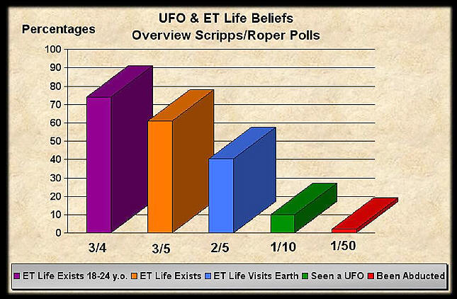

Slide 90
UFO\UFO Abductions
“A 1969 Study by the National Academy of Sciences, while recognizing there are reports “not easily explained,” concluded that “the least likely explanation of UFOs is the hypothesis of extraterrestrial visitations by intelligent beings… - Dr. Carl Sagan, author of the book CONTACT, later made into a movie.
He did not find it rational to believe that aliens were visiting us with what he called “casual impunity”.
“One theory which can no longer be taken very seriously is that UFOs are interstellar spaceships.” -Authur C. Clark British SF author, wrote 2001: A Space Odyssey
“…it’s quite possible that some of the stories that you get from people are essentially induced hallucinations in sincere witnesses – the witnesses are not lying. They really have been exposed to something genuine…” Dr. JacquesVallee- pioneer of secular UFO Research, author of 10 books, and inspiration of the scientist character in Stephen Spielberg’s movie Close Encounters of the Third Kind.
“Research has showed that some people professing to be Christians were indeed reporting that they had encountered this experience (alien abduction) in their lives. The same experience that people of all faiths or no faith had been reporting over the many years of UFO research. Research polls through the years have shown that upwards of 5 million people may have experienced some form of this phenomenon.” –CE4 Research Group http://www.alienresistance.org/ce4.htm

Slide 91
Galatians 1:8 But though we, or an angel from heaven, preach any other gospel unto you than that which we have preached unto you, let him be accursed.
An underlying message that most ‘abductees’ claim they are told by these beings. This message runs contrary to the Word of God and is in opposition to the Lordship of Jesus Christ. (What enemy of God would want to spread these lies?) Many ‘abductees’ and those that have experienced Near Death Experiences (NDE) are told:
1."We were the ones who designed all life on earth" 2. "You mistook us for gods" 3."We were at the origin of your main religions"
4.“that mankind must unite, through alien supervision, into a one-world
government and a one-world religion in order to survive”
5. Aliens profess that they are gods and they are our creators. Aliens teach that Jesus was half human, was an avatar sent from the "Spiritual Hierarchy of Masters" We are told this earth has been visited many times in the past and presently by different types of extra-terrestrials. These ET's have been involved with our creation, evolution, religions, myths, beliefs, etc.

Slide 92
The same theme runs through those that claim to have had a Near Death Experience.
1. Death is good and there is no judgment.
2) There is no hell and everyone will go to heaven.
3) The Bible is wrong and the Eastern/occult view of death is correct.
4)Occult practice is beneficial. Christian authors John Ankerberg and Robert Weldon argue, “These occult messages are frequently conveyed by the ‘being of light’ and the alleged spirits of the dead – Life After Death
These messages are nothing new but are the vain philosophies of the New Age Movement and Spiritualism. Satan was a liar from the beginning. (John 8:44 Ye are of your father the devil, and the lusts of your father ye will do. He was a murderer from the beginning, and abode not in the truth, because there is no truth in him. When he speaketh a lie, he speaketh of his own: for he is a liar, and the father of it.)

Slide 93
It is another attempt by Satan to deceive and bring authority and worship to himself. Satan sets the stage and at the appointed time Satan’s spirit will enter the antichrist and he will demand to be worshiped as God
Thessalonians 2:4 Who opposeth and exalteth himself above all that is called
God, or that is worshipped; so that he as God sitteth in the temple of God, shewing
himself that he is God.
Is it such a great or strange thing that Satan and his ministers (demons) would disguise themselves as dead loved ones or aliens in order to deceive, mislead, and hinder the plan of God? No, deceptions are within the powers of Satan, as allowed by God.
2Corinthians 11:14 And no marvel; for Satan himself is transformed into an angel
of light.
2Corinthins 11:15 Therefore it is no great thing if his ministers also be
transformed as the ministers of righteousness ; whose end shall be according to
their works.

Slide 94
Is it possible that the deceptions of Satan and his demons will work? YES, God will
allow it.
II Thessalonians 2:9-11
9Even him, whose coming is after the working of Satan with all power and signs
and lying wonders,
10 And with all deceivableness of unrighteousness in them that perish; because
they received not the love of the truth, that they might be saved.
11And for this cause God shall send them strong delusion, that they should believe
a lie:
There is also a commonality between demonic activities and the ‘alien abduction’ phenomenon that is a telling clue as to who is behind this deception. The subjection to the Authority of JESUS CHRIST.
“Through the research into the case testimonies it was found that some of the experiencers (of abductions) were able to stop or terminate the experience. There was a recognized commonality in the method that was used among the Christian experiencers. The experience was shown to be able to be stopped or terminated by calling on the name and authority of JESUS CHRIST. Not as a magic word but by their allegiance to and personal relationship with Him. CE4 Research Group http://www.alienresistance.org/ce4.htm

Slide 95
Power and Authority in the Name of Jesus Christ
The name of Jesus a name above all names. The source of the believer’s authority, strength, endurance, and power is Jesus. The name of Jesus and His Word equips us to do battle and in His name and sustained by our Faith....we cannot fail.
Proverbs 18:10
10The name of the LORD is a strong tower: the righteous runneth into it, and is safe.
Jeremiah 10:6
6Forasmuch as there is none like unto thee, O LORD; thou art great, and thy name is great
in might.
Matthew 28:18
18And Jesus came and spake unto them, saying, All power is given unto me in heaven and in
earth.

Slide 96
Power and Authority in the Name of Jesus Christ
Mark 3:11
11And unclean spirits, when they saw him, fell down before him, and cried, saying, Thou art the
Son of God.
Luke 4:41
41And devils also came out of many, crying out, and saying, Thou art Christ the Son of
God. And he rebuking them suffered them not to speak: for they knew that he was Christ.
Luke 10:17
17And the seventy returned again with joy, saying, Lord, even the devils are
subject unto us through thy name.
Acts 16:16-18
16And it came to pass, as we went to prayer, a certain damsel possessed with a spirit of
divination met us, which brought her masters much gain by soothsaying:
17The same followed Paul and us, and cried, saying, These men are the servants of the
most high God, which shew unto us the way of salvation.
18And this did she many days. But Paul, being grieved, turned and said to the spirit, I
command thee in the name of Jesus Christ to come out of her. And he came out the same
hour

Slide 97
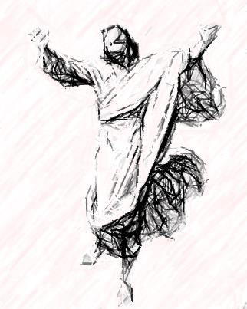
Power and Authority in the Name of Jesus Christ
James 2:19
19Thou believest that there is one God; thou doest well: the devils also believe, and tremble.
Philippians 4:13
13 I can do all things through Christ which strengtheneth me.

Slide 98
The Danger of an Unbelieving and Faltering Faith.
Hebrews 11:6
6But without faith it is impossible to please him: for he that cometh to God must
believe that he is, and that he is a rewarder of them that diligently seek him.
Acts 19:13-16
13 Then certain of the vagabond Jews, exorcists, took upon them to call over them which had evil spirits the name of the Lord Jesus, saying, We adjure you by Jesus whom Paul preacheth.
14And there were seven sons of one Sceva, a Jew, and chief of the priests, which did
so.
15And the evil spirit answered and said, Jesus I know, and Paul I know; but who are
ye?
16And the man in whom the evil spirit was leaped on them, and overcame them,
and prevailed against them, so that they fled out of that house naked and wounded.

Slide 99
The Danger of an Unbelieving and Faltering Faith.
These exorcists had no faith. All that they knew of Jesus was that He was the one ‘whom Paul preached.’ Even the name of Jesus is spoiled and is powerless on the lips of one who repeats it, parrot-like, because he has seen its power when it came flame-like from the fiery lips of some man of earnest convictions.
This absence or feebleness of personal faith is the explanation of much failure in so-called Christian work. No doubt there may be other causes for the want of success, but after all allowance is made for these, it still remains true that the chief reason why the Gospel message is often proclaimed without casting out demons is that it is proclaimed with faltering faith, tentatively and without assured confidence in its power, or imitatively, with but little, if any, inward experience of the magic of its spell. The demons have ears quick to discriminate between Paul’s fiery accents and the cold repetition of them. Incomparably the most powerful agency which any man can employ in producing conviction in others is the utterance of his own intense conviction. ‘If you wish me to weep, your own tears must flow,’ said the Roman poet. -MacLaren

Slide 100
Matthew 17:14-21
14And when they were come to the multitude, there came to him a certain man, kneeling down to
him, and saying,
15Lord, have mercy on my son: for he is lunatick, and sore vexed: for ofttimes he falleth into the fire, and oft into the water.
16And I brought him to thy disciples, and they could not cure him.
17Then Jesus answered and said, O faithless and perverse generation, how long shall I be with
you? how long shall I suffer you? bring him hither to me.
18And Jesus rebuked the devil; and he departed out of him: and the child was cured from that
very hour.
19Then came the disciples to Jesus apart, and said, Why could not we cast him out?
20And Jesus said unto them, Because of your unbelief: for verily I say unto you, If ye have faith as
a grain of mustard seed, ye shall say unto this mountain, Remove hence to yonder place; and it
shall remove; and nothing shall be impossible unto you.
21Howbeit this kind goeth not out but by prayer and fasting.
But by fasting and prayer: that is, in the exercise of a miraculous faith, expressed in solemn prayer to God, joined with fasting. It seems that Christ not only suggests, that faith was greatly wanting in his disciples; for which reason they could not cast out the devil, and heal the lunatic; but they had been wanting in prayer to God, to assist them in the exercise of their miraculous gifts. -Gill

Slide 101
The Danger of an Unbelieving and Faltering Faith.
James 1:6-7
6But let him ask in faith, nothing wavering. For he that wavereth is like a wave of the sea driven with the wind and tossed.
7For let not that man think that he shall receive any thing of the Lord.

Slide 102
Perilous Times
These “perilous times” of the “last days” will become an assault upon the church, and a dark and sinful time for mankind. 2Ti 3:1-5 1This know also, that in the last days perilous times shall come. 2For men shall be lovers of their own selves, covetous, boasters, proud, blasphemers, disobedient to parents, unthankful, unholy, 3Without natural affection, trucebreakers, false accusers, incontinent, fierce, despisers of those that are good,4Traitors, heady,highminded, lovers of pleasures more than lovers of God; 5Having a form of godliness, but denying the power thereof: from such turn away.

Slide 103
I believe that in these perilous times of the last days we will experience an increase in demonic activity and paranormal events. This belief is not without doctrinal support. 1Ti 4:1 Now the Spirit speaketh expressly, that in the latter times some shall depart from the faith, giving heed to seducing spirits, and doctrines of devils; Some key points in this verse are the “spirit speaketh expressly” this is the Holy Spirit speaking distinctly that some will depart from the faith giving heed to “seducing spirits” not seducing men, but seducing spirits. The Spirit that speaketh expressly is the Holy Spirit. The Holy Spirit is always singular.
The seducing spirits spoken of are evil spirits and the doctrines mentioned are not doctrines of men, but rather doctrines of devils. The word devil is daimon from Strong’s G1140 meaning a daemonic being, deity , and is a derivative of Strong’s G 1142 a demon or supernatural spirit (of a bad nature –devil). God does not leave us without warning for He tells us what our warfare is to be and whom it will be against, Eph 6:12 For we wrestle not against flesh and blood, but against principalities, against powers, against the rulers of the darkness of this world, against spiritual wickedness in high places.

Slide 104
It is interesting to note that the belief in supernatural and paranormal activity is on the rise especially among the secular. A 2005 Gallop poll indicated that 3 out of 4 Americans believe in the paranormal, 37% believe houses can be haunted and 21% believe they can personally communicate with the dead. In another Gallop poll comparing belief in the paranormal from 1990-2001 there is an interesting trend in that paranormal belief increased in all areas except one, which declined – the only decline in paranormal belief was in DEMON POSESSION. What is the deception here? Demons are real and they are active doing the work of Satan. Also a 2009 BARNA survey on VIEWS OF SPIRITUAL BEINGS showed the following: Four out of ten Christians (40%) strongly agreed that Satan “is not a living being but is a symbol of evil.” and most Christians do not believe that the Holy Spirit is a living force, either. Overall, 38% strongly agreed and 20% agreed somewhat that the Holy Spirit is “a symbol of God’s power or presence but is not a living entity.”
We are not prepared for the coming spiritual battle. Sun Tzu one of the greatest military minds of all time said “All war is based on deception”, “Know thy self, and know thy enemy”, “A thousand battles, a thousand victories”.”If ignorant both of your enemy and yourself, you are certain to be in peril."

Slide 105
The believer knows that spiritual warfare is real and that Satan and his demons seek to control and influence human beings, cause mental anguish suicidal mania, Luke 8:27-29 and Mark 9:22, cause physical disabilities muteness, blindness, deformities Mat. 9:32-33, Mk, 9:17-29, Mat. 12:11, Lk. 13:11-17, Mat. 17:15-18, and Lk. 9:39. We should be aware of the enemy and his devices and that we are in a spiritual warfare and we the church (the blood bought born again, worshipping in spirit and truth church) had better prepare individually and collectively.
Troubled times are coming and it is time to wake up to the reality that we are in a spiritual war. May we be prepared for the battle until the LORD calls us home and our job here is finished. 2Ti 2:3 Thou therefore endure hardness, as a good soldier of Jesus Christ. 2Ti 2:4 No man that warreth entangleth himself with the affairs of this life; that he may please him who hath chosen him to be a soldier.
R.E.G
JESUS SAVES

