Slide 1
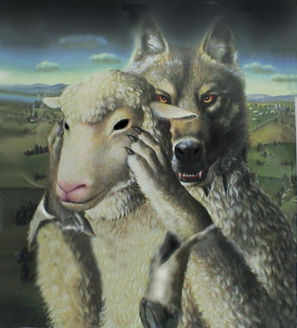
False Teachers & Teachings
MATTHEW 7:15
15 Beware of false prophets, which come to you in sheep's clothing, but inwardly they are ravening wolves.

Slide 2
False Teachings
( Word Of Faith Gospel, Prosperity Gospel, Name It And Claim It Gospel)
Belief in the "force of faith." It is believed words can be used to manipulate the faith-force, and thus actually create what they believe Scripture promises (health and wealth). Laws supposedly governing the faith-force are said to operate independently of God's sovereign will and that God Himself is subject to these laws.
It claims that God created human beings in His literal, physical image as little gods. Before the fall, humans had the potential to call things into existence by using the faith-force. After the fall humans took on Satan's nature and lost the ability to call things into existence. In order to correct this situation, Jesus Christ gave up His divinity and became a man, died spiritually, took Satan's nature upon Himself, went to hell, was born-again, and rose from the dead with God's nature. After this, Jesus sent the Holy Spirit to replicate the Incarnation in believers so they could become little gods as God had originally intended.
ROOTS OF WORD FAITH MOVEMENT: Word of Faith movement grew out of the Pentecostal movement in the latter 20th century. Its founder was E. W. Kenyon, who studied the metaphysical New Thought teachings of Phineas Quimby. Mind science (where "name it and claim it" originated) was combined with Pentecostalism, resulting in a peculiar mix of orthodox Christianity and mysticism.
Teachers: Benny Hinn, TD Jakes, Kenneth Copeland, Creflo Dollar, Rod Parsley…and many more

Slide 3
We Are Warned…..
Titus 1: 10-11
10 For there are many unruly and vain talkers and deceivers, specially they of the circumcision:
11 Whose mouths must be stopped, who subvert whole houses, teaching things which they ought not, for filthy lucre's sake.
lucre = money, gained deceitfully.

Slide 4
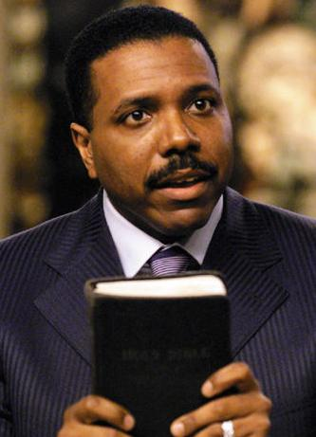
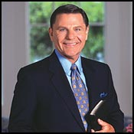
FALSE TEACHERS
Creflo Dollar & Kenneth Copeland
        Creflo....Show Me The Money
Copelands True Colors
The Money Two-Step

Slide 5
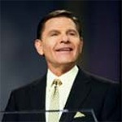
Copelands False Doctrines
That we do not have a god in us but that we are a God.
“You don’t have a God in you. You are one!” -
God is the greatest failure in the Universe
"I was shocked when I found out who the biggest failure in the Bible actually is....The biggest one is God....I mean, He lost His top-ranking, most anointed angel; the first man He ever created; the first woman He ever created; the whole earth and all the Fullness therein; a third of the angels, at least--that's a big loss, man. . . “
God has no right to the earth at all, he needs an invitation
"God had no avenue of lasting faith or moving in the earth. He had to have covenant with somebody. . . . He had to be invited in, in other words, or He couldn't come. God is on the outside looking in. In order to have any say so in the earth, He's gonna have to be in agreement with a man here."
REALLY?

Slide 6
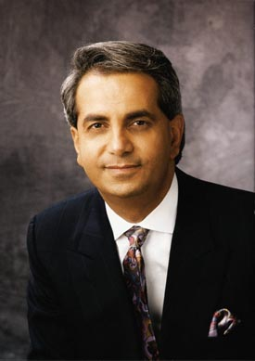
FALSE TEACHER, HEALER ,AND PROPHET
Benny Hinn
Teaches Word Of Faith Doctrine
Benny Hinn falsely predicted that all the homosexuals in America would die by fire in the late 1990's.
Jesus Christ will personally appear on the platform in one of his crusades.
Fidel Castro will die in the 1990'S
Confessed that there are 9 beings within the Godhead. 3 beings (Tritheism) each having their own trinity of beings within each.

Slide 7
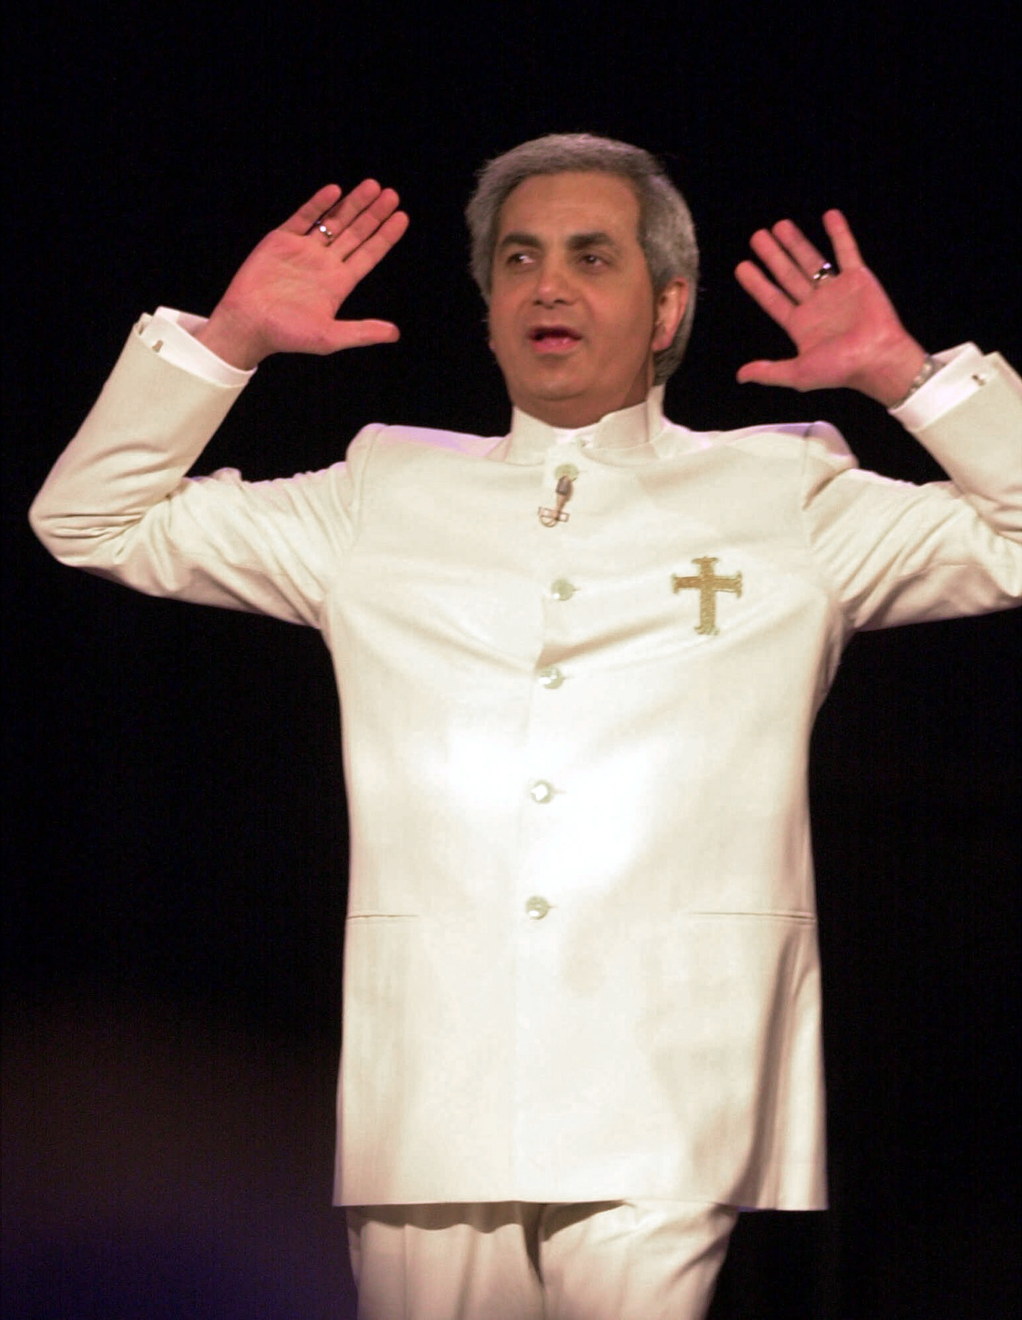
FAITH HEALER???????
Faith Healer??????
Money Money Money....
Biblical Standard For Healers
  He will meet the Biblical example and heal everyone that comes to him for healing.
  He will heal any form of sickness known to man.
  He will heal any illness completely.
  The total healing will take place instantly without regard for the depth of the afflicted person’s faith.

Slide 8
How To Know A False Prophet
Deuteronomy 18:21-22
21 And if thou say in thine heart, How shall we know the word which the LORD hath not spoken?
22 When a prophet speaketh in the name of the LORD, if the thing follow not, nor come to pass, that is the thing which the LORD hath not spoken, but the prophet hath spoken it presumptuously: thou shalt not be afraid of him.

Slide 9
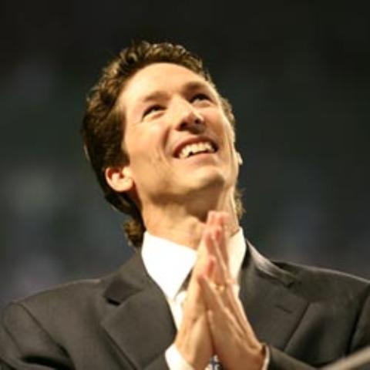
Joel Osteen
Preaches Word Faith (Prosperity) Doctrine and Universalism.
What?????
Ephesians 1: 4
4 According as he hath chosen us in him before the foundation of the world, that we should be holy and without blame before him in love:
Preaches Universalism
  a system of religious beliefs maintaining that all men are predestined for salvation
  Not My Way
  Mark 8:38
  38 Whosoever therefore shall be ashamed of me and of my words in this adulterous and sinful generation; of him also shall the Son of man be ashamed, when he cometh in the glory of his Father with the holy angels.
  True Christians???

Slide 10
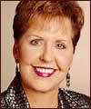
Joyce Meyer
Word-Faith Preacher
Claims Not To Be A Sinner.. I Am Righteous
Claims Private Revelation.. Trust Me To Explain It
Teaches Jesus ceased to be God on the cross.
Teaches ‘born again Jesus’ doctrine: teaches Jesus died two deaths, one physically on the cross the other spiritually in hell where he was tortured the days and nights by Satan and his demons, was born again in hell reclaiming his deity and finally raising bodily from the dead.
.

Slide 11
God Said….
Romans 3:23
23 For all have sinned, and come short of the glory of God;
Romans 3:10
10 As it is written, There is none righteous, no, not one:
I John 1:8
8 If we say that we have no sin, we deceive ourselves, and the truth is not in us
II Peter 1:20
20 Knowing this first, that no prophecy of the scripture is of any private interpretation

Slide 12
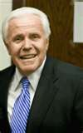
Jesse Duplantis
Word-Faith Preacher
Jesse said He Visited Heaven. Jesse says that in Aug 1988 he was transported by a Chariot to Heaven and he saw and talked one-on-one with: Jesus Christ, King David, Apostle Paul, Abraham,
You Decide When You Die
Out Of Context

Slide 13
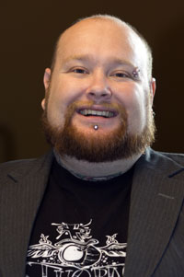
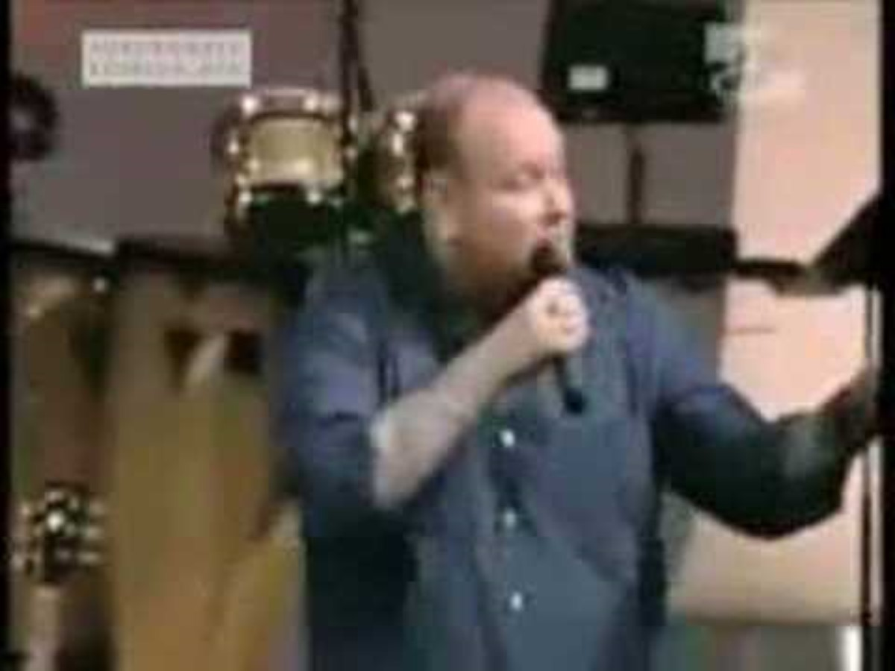
Todd Bentley-False Everything
Latter Rain\New Apostolic\Modern Day Prophet Movement
When You Thought It Couldn't Get Any Worse

Slide 14
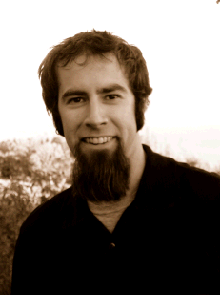
John Crowder
Contemplative Spirituality, Mysticism,
Latter Rain\New Apostolic\Modern Day Prophet Movement
It Got Worse..No Kidding.

Slide 15
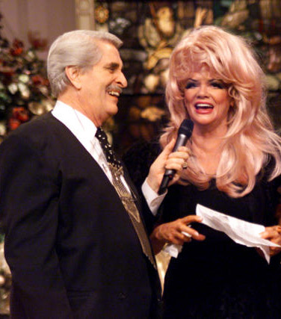
TBN-Trinity Broadcasting Network
Worlds Largest Religious Network
Largest Christian Broadcasting Network
Americas Most Watched Faith Channel
3rd Largest Over-The- Air Network In The United States, ahead of: CBS, FOX, NBC
24 hr. Commercial Free Programming
Net Worth Approx 2 Billion Dollars, Bring in 200 Million Annually
Founders: Paul and Jan Crouch

Slide 16
Paul and Jan Crouch
TBN=The Blasphamy Network
Teach Word Of Faith Doctrine
Christians Are Little Gods
“if you have been healed or saved or blessed through TBN and have not contributed to (the) station, you are robbing God and will lose your reward in heaven” - Paul Crouch
God, we proclaim death to anything or anyone that will lift a hand against this network and this ministry that belongs to You, God. It is Your work, it is Your idea, it is Your property, it is Your airwaves, it is Your world, and we proclaim death to anything that would stand in the way of God's great voice of proclamation to the whole world. In the Name of Jesus, and all the people said Amen! - Paul Crouch
HERETICS

Slide 17
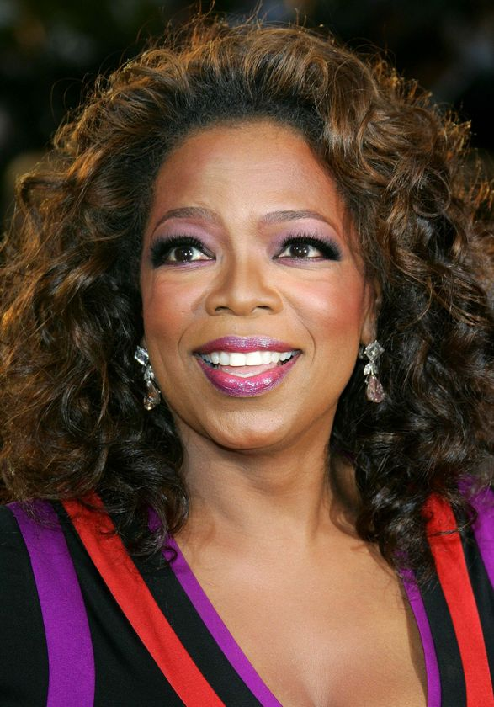
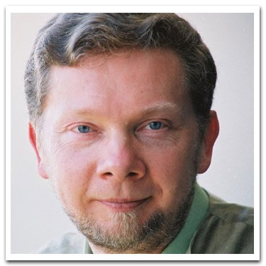
Oprah Winfrey &
Eckhart Tolle
Espouses New Age Spirituality
Denies Jesus IS Only Way
Jesus Didn’t Come To Die On Cross
Eastern Mysticism
Promotes New Age Guru-Eckhart Tolle
Her Influence On The Public Has Been Called The ‘Oprah Effect”
DON'T DRINK THE KOOL-AID

Slide 18
GOD SAYS…
II Peter 2: 1-3, 14-15
1 But there were false prophets also among the people, even as there shall be false teachers among you, who privily shall bring in damnable heresies, even denying the Lord that bought them, and bring upon themselves swift destruction.
2 And many shall follow their pernicious ways; by reason of whom the way of truth shall be evil spoken of.
3 And through covetousness shall they with feigned words make merchandise of you: whose judgment now of a long time lingereth not, and their damnation slumbereth not.
14 Having eyes full of adultery, and that cannot cease from sin; beguiling unstable souls: an heart they have exercised with covetous practices; cursed children:
15 Which have forsaken the right way, and are gone astray, following the way of Balaam the son of Bosor, who loved the wages of unrighteousness;

Slide 19
God Says…
II Peter 2:17-19
17 These are wells without water, clouds that are carried with a tempest; to whom the mist of darkness is reserved for ever.
18 For when they speak great swelling words of vanity, they allure through the lusts of the flesh, through much wantonness, those that were clean escaped from them who live in error.
19 While they promise them liberty, they themselves are the servants of corruption: for of whom a man is overcome, of the same is he brought in bondage.
Romans 16:17-18
17 Now I beseech you, brethren, mark them which cause divisions and offences contrary to the doctrine which ye have learned; and avoid them.
18 For they that are such serve not our Lord Jesus Christ, but their own belly; and by good words and fair speeches deceive the hearts of the simple.

Slide 20
God Says…
I Timothy 4:1
1 Now the Spirit speaketh expressly, that in the latter times some shall depart from the faith, giving heed to seducing spirits, and doctrines of devils;
Phillipians 3: 18-19
18 (For many walk, of whom I have told you often, and now tell you even weeping, that they are the enemies of the cross of Christ:
19 Whose end is destruction, whose God is their belly, and whose glory is in their shame, who mind earthly things.)
Colossians 2:8
8 Beware lest any man spoil you through philosophy and vain deceit, after the tradition of men, after the rudiments of the world, and not after Christ.

Slide 21
God Says…
II Peter 2: 21-22
21 For it had been better for them not to have known the way of righteousness, than, after they have known it, to turn from the holy commandment delivered unto them.
22 But it is happened unto them according to the true proverb, The dog is turned to his own vomit again; and the sow that was washed to her wallowing in the mire.

Slide 22
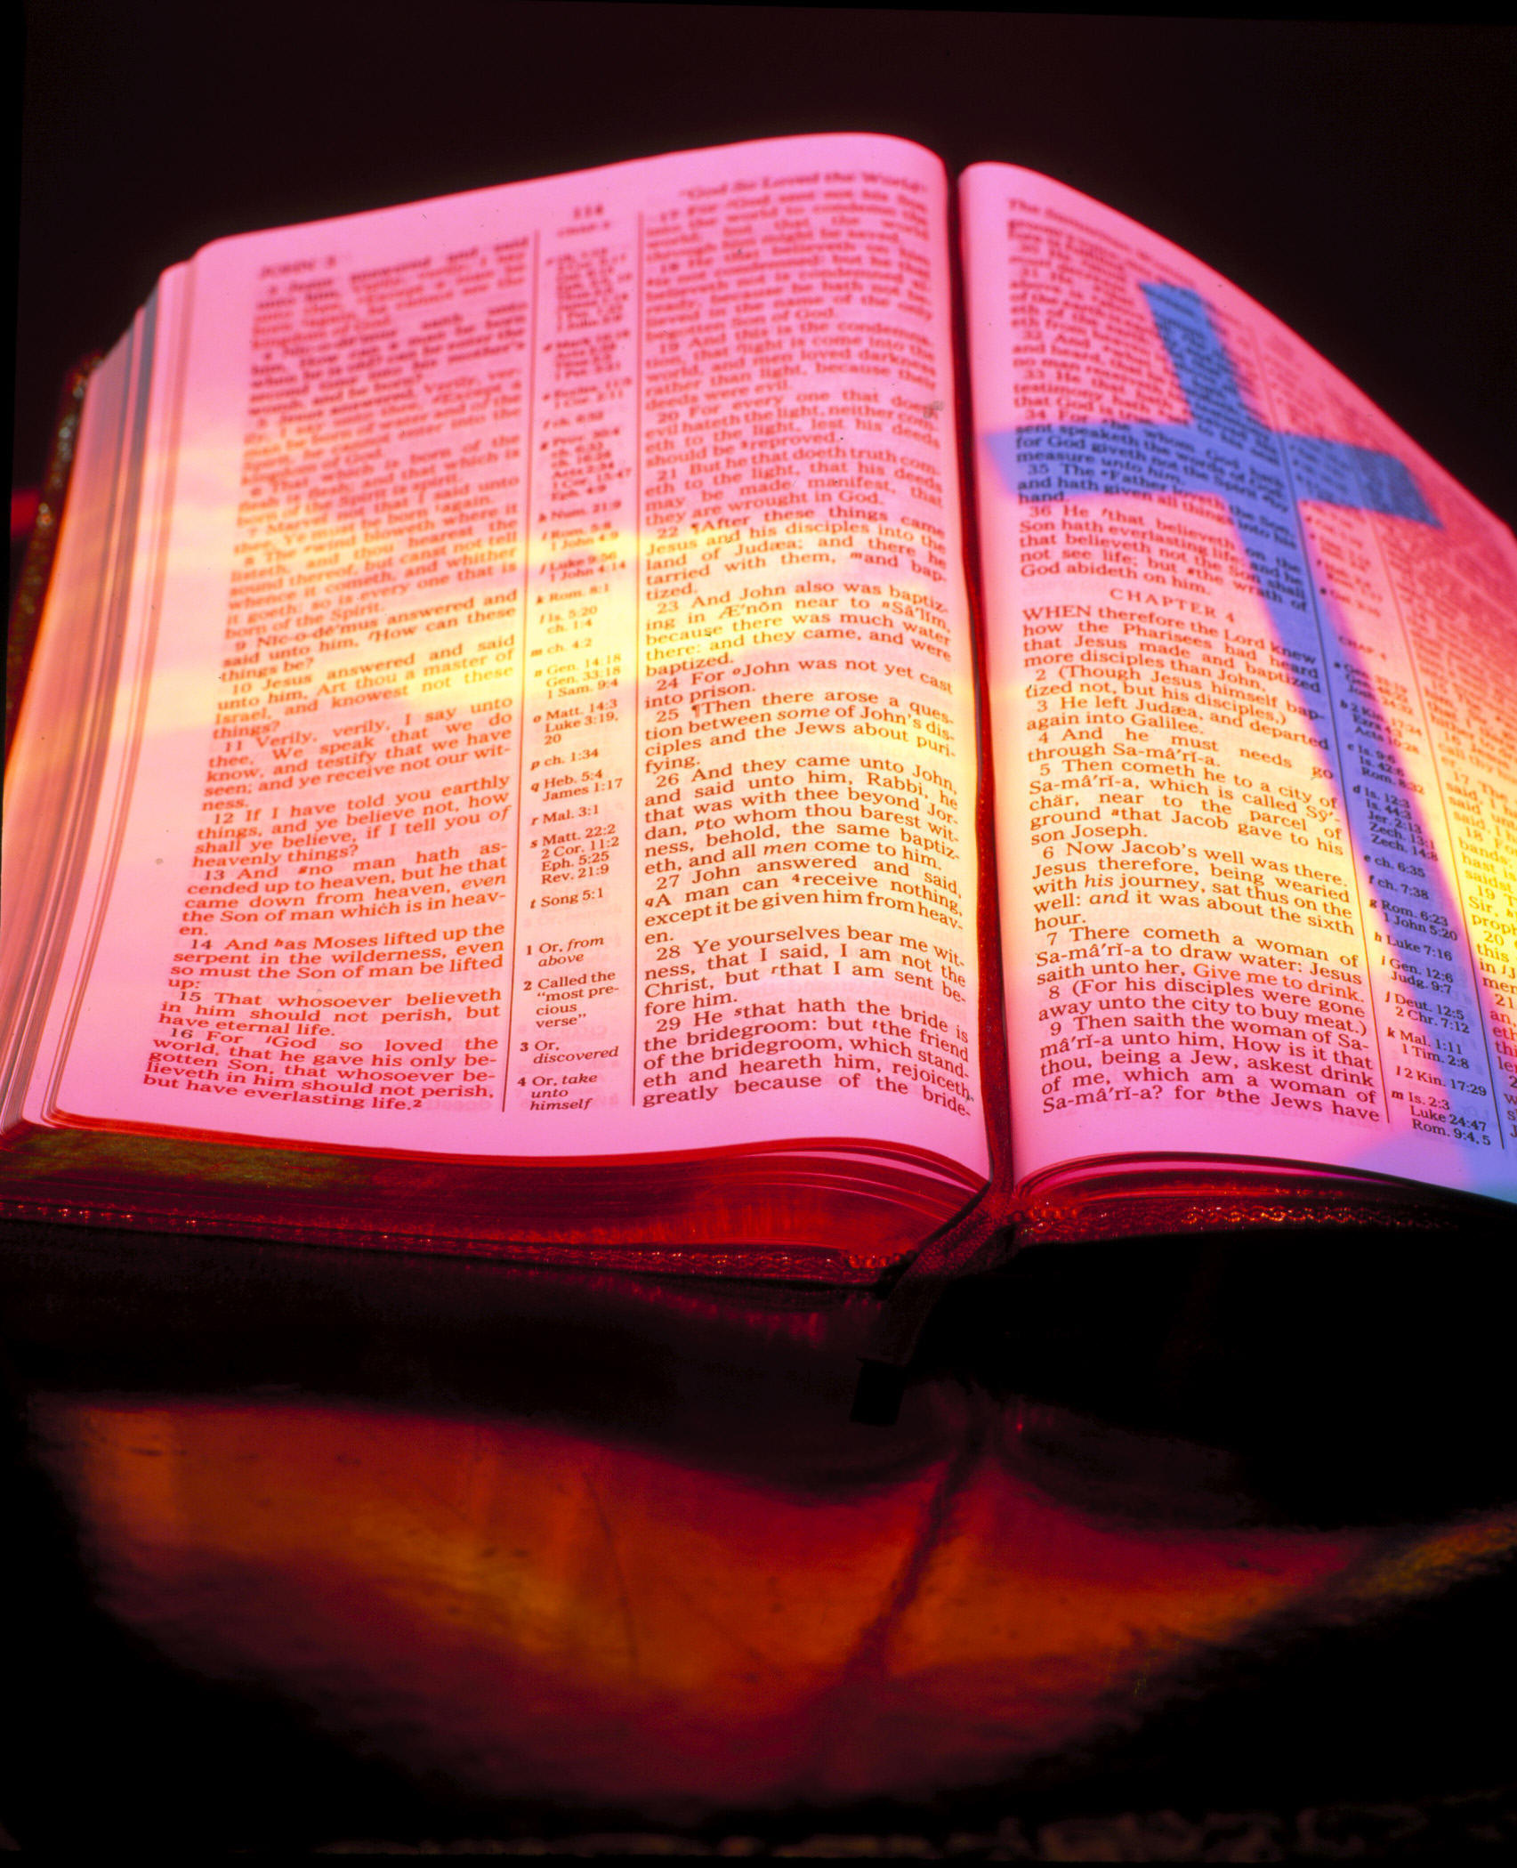
Sola Scripture… The Bible contains all knowledge necessary for salvation and holiness. Scripture Alone.

Slide 23
Solus Christus….By Christ Alone
Sola gratia….By Grace Alone
Sola fide….By Faith Alone
Soli Deo gloria….Glory To God Alone

