Slide 1
This Bible Study Contains HYPER LINKS to videos in some of the images\pictures. Be sure to check all images\pictures for hyperlinks God Bless 2Timothy 2:15 Study to shew thyself approved unto God, a workman that needeth not to be ashamed, rightly dividing the word of truth.

Slide 2
THE MARK OF THE BEAST
REVELATION 13:16-18
There Will Be A One World Government
There Will Be A One World Religion
THERE WILL BE A MARK

Slide 3
“I Believe In Christianity as I Believe The Sun Has Risen; Not Only Because I See It, But Because By It I See Everything Else” – C.S. Lewis
WHY DO I BELIEVE THIS?
‘Christianity Is Not A Religion, It Is A Reality’

Slide 4
But Brother Rick… I Am Blood Bought Born Again, I’ll Be Gone In The Rapture When These Thing Happen.. Why Should I Worry About Them?
EZEKIEL 3:19-20
19Yet if thou warn the wicked, and he turn not from his wickedness, nor from his wicked way, he shall die in his iniquity; but thou hast delivered thy soul.
20Again, When a righteous man doth turn from his righteousness, and commit iniquity, and I lay a stumbling block before him, he shall die: because thou hast not given him warning, he shall die in his sin, and his righteousness which he hath done shall not be remembered; but his blood will I require at thine hand.

Slide 5
THE MARK OF THE BEAST
REVELATION 13: 16-18
16And he causeth all, both small and great, rich and poor, free and bond, to receive a mark in their right hand, or in their foreheads:
17And that no man might buy or sell, save he that had the mark, or the name of the beast, or the number of his name.
18Here is wisdom. Let him that hath understanding count the number of the beast: for it is the number of a man; and his number is Six hundred threescore and six.
Charagma 5480
mark= khar'-ag-mah
From the same as G5482; a scratch or etching, that is, stamp (as a badge of servitude), or sculptured figure (statue): - graven, mark.

Slide 6
Revelation 13:16-17
16And he causeth all, both small and great, rich and poor, free and bond, to receive a mark in their right hand, or in their foreheads:
17And that no man might buy or sell, save he that had the mark, or the name of the beast, or the number of his name.
a mark
And he causeth all, both small and great, rich and poor, free and bond, to receive a mark
no man might buy or sell, save he that had the mark, or the name of the beast, or the number of his name
TECHNOLOGY
IMPLEMENTATION
ENFORCEMENT

Slide 7
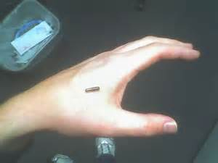
TECHNOLOGY of the MARK {Its What Is Best For The People}
RFID Chip: Radio Frequency Identification-wireless no contact use for transferring data and for automatically identifying tags, labels attached to an object-also has GPS capabilities
STICK ME
In 2004 The FDA Approved The Implantable RFID Chip For human Use.

Slide 8
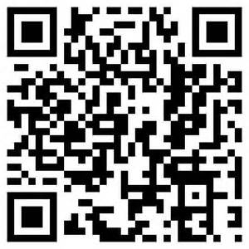
QR CODE (Quick Response Code)
Two dimensional bar code, popular because of its fast readability, great storage capacity- used for product tracking, item identification, time tracking.
All merchandise now is identified with a RFID (radio-frequency identification) labels or the QR (Quick Response (QR) Code for electronic tracking. A smart phone can read the QR Code. The International Business Machines Corporation (“IBM”) is now working to identify and track every item manufactured and sold in the world; this is in the trillions. Then it will be very easy to match these items with the purchaser. With the rapidly advancing technology, this is not far off.

Slide 9
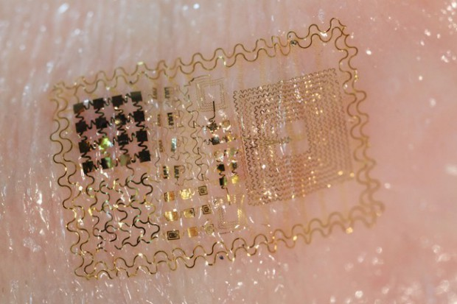
EES (Epidermal Electronic System)
Known also as electronic skin. It is a ultra thin, self adhesive electronic device that integrates with the skin in a way that is mechanically and physiologically invisible to the user.

Slide 10
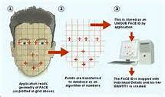
Facial Recognition Systems
Is a computer application for automatically identifying or verifying a person from a digital image or a video frame from a video source. One of the ways to do this is by comparing selected facial features from the image and a facial database.
It is typically used in security systems and can be compared to other biometrics such as fingerprint or eye iris recognition systems
FACE

Slide 11
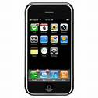
Now We can Even Spy On Each Other
Cell Phone Monitoring Software empowers you to get the answers you truly want and deserve. Including a host of advanced surveillance features, our Cell Phone monitoring Software secretly tracks all cell phone activities and sends the information back to your Mobistealth user account. You can download, install and start using Mobistealth Cell Phone tracking Software in just minutes.
It is an advanced tracking software tool which helps you to track all the mobile as well as system activities performed by your kids, employees or whoever you want to put under the scanner.
No One Will Ever Know They Are Being Monitored.
Mark 13:12 Now the brother shall betray the brother to death, and the father the son; and children shall rise up against their parents, and shall cause them to be put to death.

Slide 12
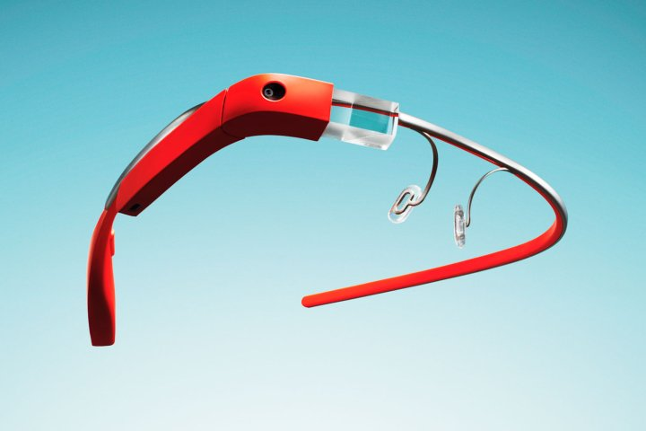
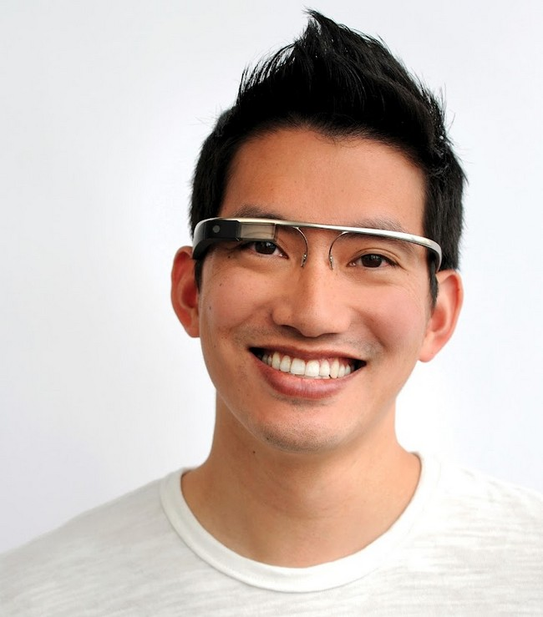
Google Glass -augmented reality computer
computer\phone with GPS and WIFI capabilities. Photo and video capabilities

Slide 13
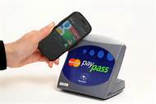
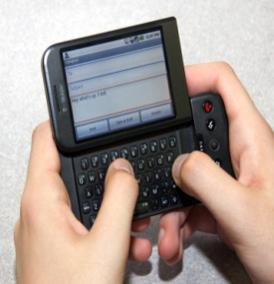
Google Wallet
is a mobile payment system developed by Google that allows its users to store debit cards, credit cards, loyalty cards, and gift cards. Google Wallet can use near field communication (NFC) to "make secure payments fast and convenient by simply tapping the phone on any PayPass-enabled terminal at checkout."
GO CASHLESS

Slide 14
THE MIND OF GOD
Sergey Brin co-founder of Google –”The perfect search engine would be like the mind of God”.
Gods Character\Mind:
Omniscience – knowing all things at once, universal knowledge
Omnipotence – all mighty power, unlimited or infinite power
Omnipresence – presence in every place at the same time, unbounded universal presence.

Slide 15
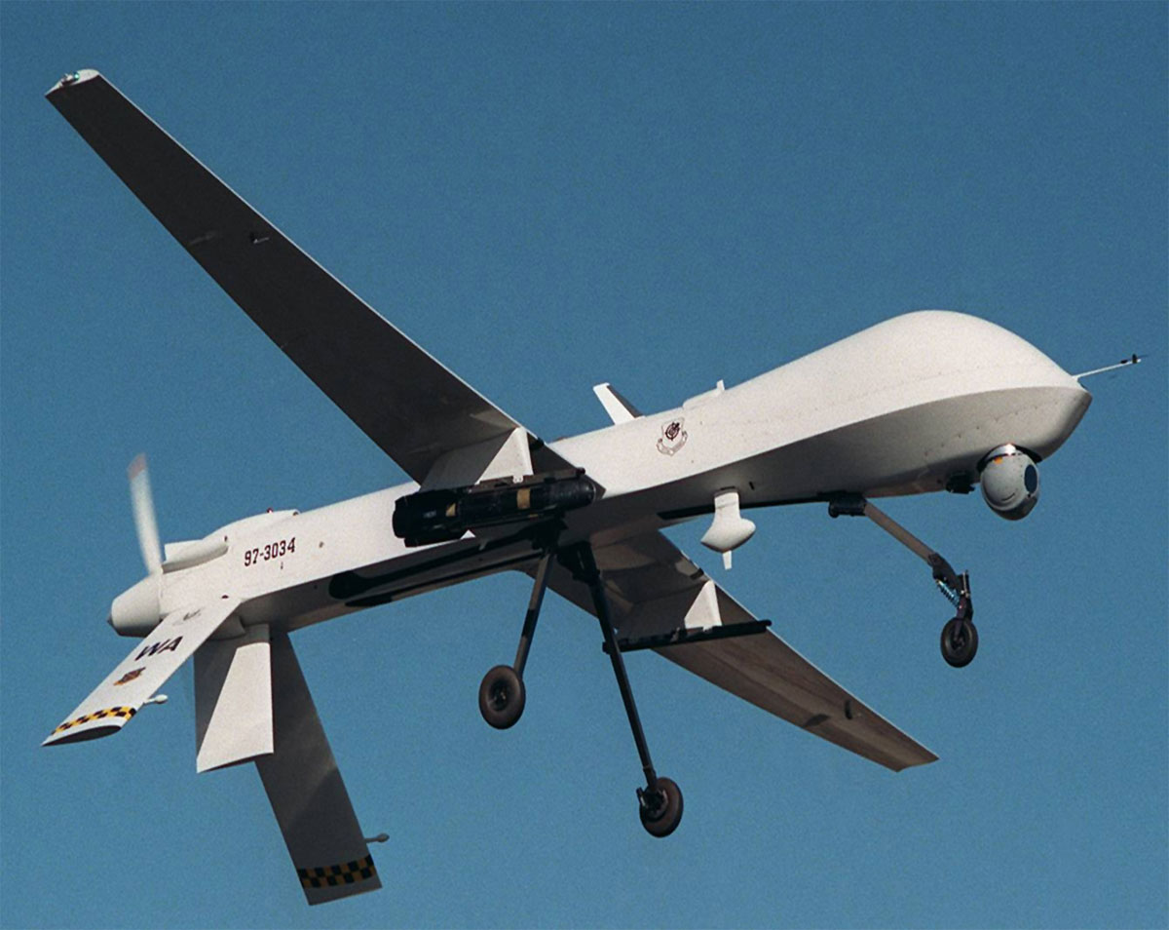
Drone
An unmanned aerial vehicle (UAV), is an aircraft without a human pilot on board. Its flight is controlled either autonomously by computers in the vehicle or under the remote control of a pilot on the ground or in another vehicle. The typical launch and recovery method of an unmanned aircraft is by the function of an automatic system or an external operator on the ground. By 2015 U.S. Government plans for 30,000 surveillance drones in the sky - THE U.S. SKY.

Slide 16
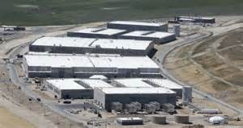
NSA-Utah Data Center (UDC)
$2,000,000,000 complex with 100,000 sq. ft. of computer space. All global information will be routed through the UDC. Everything about you that is digitized will be stored there, down to parking tickets.
Computer named Titan. Titan was the name of the extremely powerful and huge gods that ruled the earth during the legendary Golden Age of mankind.

Slide 17
Implementation of the MARK {Its What Is Best For The People}
Advertising is the most potent influence in changing the habits and modes
of life affecting what we eat, what we wear, and the work and play of a whole nation –President Calvin Coolidge, 1923
VERITEQ
COGNITEC
Verizon DROID

Slide 18
{1973, Senior Scholastics introduced school age children to the concept of buying and selling using numbers inserted in their forehead. In the September 20, 1973 feature "Who Is Watching You?" the secular high school journal speculated: "All buying and selling in the program will be done by computer. No currency, no change, no checks. In the program, people would receive a number that had been assigned them tattooed in their wrist or forehead. The number is put on by laser beam and cannot be felt. The number in the body is not seen with the naked eye and is as permanent as your fingerprints. All items of consumer goods will be marked with a computer mark. The computer outlet in the store which picks up the number on the items at the checkstand will also pick up the number in the person's body and automatically total the price and deduct the amount from the person's 'Special Drawing Rights' account." }
{In the 1974 article "The Specter of Eugenics," Charles Frankel pointed out Linus Pauling's (Nobel Prize winner) suggestions that a mark be tattooed on the foot or forehead of every young person. Pauling envisioned a mark denoting genotype.}
In 1980, U.S. News and World Report continued the warning, pointing out that the Federal Government was contemplating "National Identity Cards," without which nobody could work or conduct business.

Slide 19
{The Denver Post Sun followed up in 1981, claiming that chip implants could someday replace I.D. cards. The June 21, 1981 story read in part, "The chip is placed in a needle which is affixed to a simple syringe containing an anti-bacterial solution. The needle is capped and ready to forever identify something--or somebody.“}
{On April 27, 1998, Time Magazine ran the story, The Big Bank Theory And What It Says About The Future OF Money, in which they opined "Your daughter can store the money any way she wants--on her laptop, on a debit card, even (in the not too distant future) on a chip implanted under her skin.“}
{On the Today Show viewers watched an American family get "chipped" with ADS's VeriChip™ live from a doctor's office in Boca Raton,FL.}

Slide 20
One World Economy\Cashless Society
TOP 8 CASHLESS COUNTRIES
1. Belgium (93 percent)
2. France (92 percent)
3. Canada (90 percent)
4. Tie: United Kingdom and Sweden (89 percent)
6. Australia (86 percent)
7. Netherlands (85 percent)
8. United States (80 percent)

Slide 21
2010 Biometric cash machines begin to appear in Europe
2010 Obama administration starts plans to require all American workers to obtain National biometric ID cards. “Believe System” Biometric Enrollment Locally stored Information and Electronic Verification of Employment
2010 Germany rolls out National ID cards with RFID technology
2010 FBI launches a 1 billion dollar facial recognition project
2011 Obama administration begins plans to create a internet ID for all Americans-National Strategy for Trusted Identities in Cyberspace
.

Slide 22
REAL ID Act – Title II
1
H.R.1268
Emergency Supplemental Appropriations Act for Defense, the Global War
on Terror, and Tsunami Relief, 2005 (Enrolled as Agreed to or Passed by
Both House and Senate)
Dec. 20, 2013 | The Department of Homeland Security (DHS) announced that phased in enforcement of the REAL ID Act will begin on Jan. 20, 2014.
STAR ID – Alabama
STAR ID. STAR stands for Secure Trusted and Reliable Identification.
Alabama developed the program to comply with federal law written after 9/11.
"All but one of the terrorists on 9/11 had fraudulent ids. Congress wants to verify who people are," said Capt. Guy Rush with the Alabama Department of Public Safety.
Rush says starting Dec. 1 of this year, people born after Dec. 1, 1964 will be required to have a STAR ID if they want to board a commercial airline or access regulated federal facilities like a federal courthouse or nuclear plant.
People born on or before Dec. 1, 1964 will have to get the ID by Dec. 1, 2017.

Slide 23
The Internet
2.1 Billion Internet Users in 2013
(Approximately 1\3 of Worlds Population)
We are being conditioned to use the internet in our daily lives for BUYING, SELLING,ENTERTAINMENT,SOCIAL COMMUNICATION, ACCESS OF INFORMATION.
WHAT IF ACCESS TO THE WORLD WIDE WEB BECAME REGULATED???
WHAT IF YOU HAD TO HAVE A LICENSE OR BIOMETRIC ID TO ACCESS THE INTERNET

Slide 24
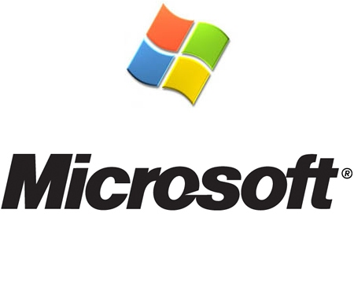
Craig Mundie, chief research and strategy officer for Microsoft, told fellow globalists at the summit that the Internet needed to be policed by means of introducing licenses similar to drivers licenses – in other words government permission to use the web.
“We need a kind of World Health Organization for the Internet,” he said.
Another method would be to make the use of fingerprint scanners that are included on a lot of new computer models mandatory. You would have to register your fingerprint at a central government data center and then scan each time you want to access the Internet. Misbehave online and your access will be denied.

Slide 25
EROSION OF PERSONAL LIBERTY
Erosion of Privacy – Patriot Act
Erosion of Property Right - Eminent Domain, Agenda 21
Erosion of Free Speech – (CTC) Combating Terrorism Center
Any criticism of the US President and members of congress are being viewed as hostile and will get you labeled as a terrorist or unpatriotic radical.

Slide 26
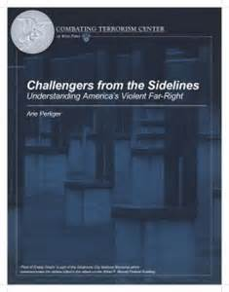
Combating Terrorism Center-West Point
A West Point think tank has issued a paper warning America about “far right” groups such as the “anti-federalist” movement, which supports “civil activism, individual freedoms and self-government.”
The center— part of the institution where men and women are molded into Army officers — posted the report Tuesday. It lumps limited government activists with three movements it identifies as “a racist/white supremacy movement, an anti-federalist movement and a fundamentalist movement.”
The report also draws a link between the mainstream conservative movement and the violent “far right,” and describes liberals as “future oriented” and conservatives as living in the past.

Slide 27
“The far right represents a more extreme version of conservatism, as its political vision is usually justified by the aspiration to restore or preserve values and practices that are part of the idealized historical heritage of the nation or ethnic community.”
The report adds: “While far-right groups’ ideology is designed to exclude minorities and foreigners, the liberal-democratic system is designed to emphasize civil rights, minority rights and the balance of power.”
“The anti-abortionists have been extremely productive during the last two decades, amassing 227 attacks, many of them perpetrated without the responsible perpetrators identified or caught. And while, in both cases, the 1990s were more violent than the last decade, in the case of anti-abortion, the trend is much more extreme, as 90 percent of attacks were perpetrated before 2001.”
“In the case of Israel, far right designation is strongly linked to views which justify extreme means for preserving Israel’s control over the West Bank and Gaza Strip, and the promotion of the idea of “the Greater Land of Israel.” In both Israel and the United States the far right encompasses strong religious dimensions, since in both countries religious ideology and fundamentalist interpretation of holy texts are frequently suborned as justification for far right extremism. “
“Some groups are driven by a strong conviction that the American political system and its proxies were hijacked by external forces interested in promoting a “New World Order,” (NWO) in which the United States will be embedded in the UN or another version of global government.”

Slide 28
Enforcement of the MARK {Its What Is Best For The People}
USA Patriot Act
Signed into law during the 107th United States Congress on October 26, 2001, sneak and peek warrants for the first time in United States history were used as standard procedure in investigations. Sneak and peek warrants are addressed in Section 213, under Title II or the Enhanced Surveillance Procedures. These warrants are not exclusive to acts of foreign and domestic terrorism. Sneak and peek warrants are applicable to any federal crime including misdemeanor.
Allows the FBI to search telephone, email, and financial records without a court order
Section 215 allows the FBI to apply for an order to produce materials that assist in an investigation undertaken to protect against international terrorism or clandestine intelligence activities. Among the "tangible things" that could be targeted, it includes "books, records, papers, documents, and other items".

Slide 29
Digital Telephony and Communications Privacy Act
Telecommunications carrier shall ensure that its equipment, facilities, or services that provide a customer or subscriber with the ability to originate, terminate, or direct communications are capable of"
enabling the government, pursuant to a court order, to intercept all wire and electronic communications carried by the carrier
enabling the government, pursuant to a court order, to access call-identifying information that is available to the carrier
delivering the above communications/information to the government "in a format such that they may be transmitted by means of equipment, facilities, or services procured by the government to a location other than the premises of the carrier" - (UTAH DATA CENTER?)
doing the above unobtrusively and with a minimum of interference with any subscriber's telecommunications service and in a manner that protects both the privacy and security of communications not authorized to be intercepted and the information regarding the government's interception of communications .
In cases of non-compliance, the Attorney General may obtain an order directing that a telecommunications carrier comply with the Act. Non-compliance can be punished by civil penalty of up to $10,000 per day for each day in violation after the issuance of the order.

Slide 30
Executive Orders
EXECUTIVE ORDER 10995 allows the government to seize and control the communication media.
EXECUTIVE ORDER 10997 allows the government to take over all electrical power, gas, petroleum, fuels and minerals.
EXECUTIVE ORDER 10998 allows the government to seize all means of transportation, including personal cars, trucks or vehicles of any kind and total control over all highways, seaports, and waterways.
EXECUTIVE ORDER 10999 allows the government to take over all food resources and farms.
EXECUTIVE ORDER 11000 allows the government to mobilize civilians into work brigades under government supervision.
EXECUTIVE ORDER 11001 allows the government to take over all health, education and welfare functions.
EXECUTIVE ORDER 11002 designates the Postmaster General to operate a national registration of all persons.
EXECUTIVE ORDER 11003 allows the government to take over all airports and aircraft, including commercial aircraft.
EXECUTIVE ORDER 11004 allows the Housing and Finance Authority to relocate communities, build new housing with public funds, designate areas to be abandoned, and establish new locations for populations.

Slide 31
Executive Orders
EXECUTIVE ORDER 11005 allows the government to take over railroads, inland waterways and public storage facilities.
EXECUTIVE ORDER 11921 allows the Federal Emergency Preparedness Agency (FEMA) to develop plans to establish control over the mechanisms of production and distribution, of energy sources, wages, salaries, credit and the flow of money in U.S. financial institution in any undefined national emergency. It also provides that when a state of emergency is declared by the President, Congress cannot review the action for six months
REVELATION13:17And that no man might buy or sell, save he that had the mark, or the name of the beast, or the number of his name.

Slide 32
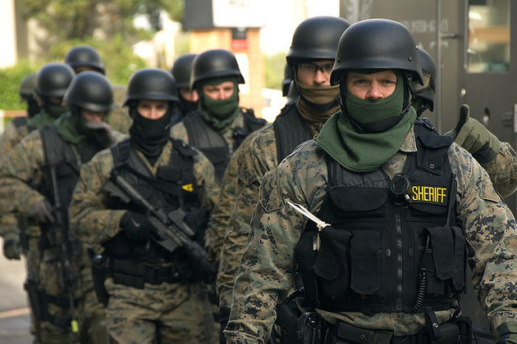
Militarization Of Police Force

Slide 33
WHAT IS THE FUTURE FOR THOSE THAT RECEIVE THE MARK
Revelation 14:9-11
9And the third angel followed them, saying with a loud voice, If any man worship the beast and his image, and receive his mark in his forehead, or in his hand,
10The same shall drink of the wine of the wrath of God, which is poured out without mixture into the cup of his indignation; and he shall be tormented with fire and brimstone in the presence of the holy angels, and in the presence of the Lamb:
11And the smoke of their torment ascendeth up for ever and ever: and they have no rest day nor night, who worship the beast and his image, and whosoever receiveth the mark of his name.
Revelation 19:20
20And the beast was taken, and with him the false prophet that wrought miracles before him, with which he deceived them that had received the mark of the beast, and them that worshipped his image. These both were cast alive into a lake of fire burning with brimstone.

Slide 34
WHAT SHOULD WE DO?
“In times of extraordinary crisis ordinary measures will not suffice. The world lives in such a time of crisis. Christians alone are in a position to rescue the perishing. We dare not settle down to try to live as if things were normal.” – A.W. Tozer
As you begin each day, “put on” the armor of God. Consciously say, “Lord, I'm putting on the helmet of the hope of my salvation and the breastplate of righteousness”—all the way down to your feet. And take up the Sword of the Spirit and the shield of faith.
Adrian Rogers

Slide 35
TELL PEOPLE ABOUT JESUS
Matthew 5:16
Let your light so shine before men, that they may see your good works, and glorify your Father which is in heaven.
Matthew 28:19-20
Go ye therefore, and teach all nations, baptizing them in the name of the Father, and of the Son, and of the Holy Ghost:
20Teaching them to observe all things whatsoever I have commanded you: and, lo, I am with you alway, even unto the end of the world. Amen.
Romans 10:9-10
9That if thou shalt confess with thy mouth the Lord Jesus, and shalt believe in thine heart that God hath raised him from the dead, thou shalt be saved.
10 For with the heart man believeth unto righteousness; and with the mouth confession is made unto salvation.

Slide 36
The Sword Of The Spirit
Suppose you were on the battlefield and someone’s coming at you. You warn him, “Don't come any further! I'll shoot!” He answers, “I don't believe in your gun. As a matter of fact,” he says, “I don't believe in guns at all.” That's not going to change anything, is it?
Likewise, the Bible is the Sword of the Spirit. Someone may say, “Well, I don't believe the Bible.” But it will cut him anyway! The apostles preached the Bible, and when the people heard it, they were cut to the heart. The Word cuts even an unbeliever. It's a two-edged sword. It cuts to heal, or it cuts to judge. But it will cut—believe it or not.
Before going into battle, soldiers are dedicated to training in the use of their weapons. How foolish to go into battle without training. How familiar are you with your Sword?
God has given you a weapon for spiritual battles…the Sword of the Spirit. In the armor of God, it is the only offensive weapon—the rest are defensive. To have the victory God wants for you, you must see the sharpness of your sword, the Bible, and you must be trained in it. – Adrian Rogers
www.swordofthespiritmind.com

Slide 37
AMEN

