Slide 1
Daniel 3:5 That at what time ye hear the sound of the cornet, flute, harp, sackbut, psaltery, dulcimer, and all kinds of musick, ye fall down and worship the golden image that Nebuchadnezzar the king hath set up:
Cornets, Flutes and Harps
And ALL KINDS OF MUSIC
Daniel 3:7 Therefore at that time, when all the people heard the sound of the cornet, flute, harp, sackbut, psaltery, and all kinds of musick, all the people, the nations, and the languages, fell down and worshipped the golden image that Nebuchadnezzar the king had set up.

Slide 2
Music directly imitates the passions or states of the soul...when one listens to music that imitates a certain passion, he becomes imbued with the same passion; and if over a long time he habitually listens to music that rouses ignoble passions, his whole character will be shaped to an ignoble form. -Aristotle
Musical training is a more potent instrument than any other, because rhythm and harmony find their way into the inward places of the soul, on which they mightily fasten, imparting grace, and making the soul of him who is rightly educated graceful, or of him who is ill-educated ungraceful. -Socrates
Music is part of us, and either ennobles or degrades our behavior. - Boethuis
“for changing people’s manners and altering their customs there is nothing better than music. – Shu Ching

Slide 3
"People there are, not a few, who have pipe organ abilities and make no more music for the causes of Christ than a wheezy saxophone in an idiot's hands."
—Dr. R.G. Lee

Slide 4
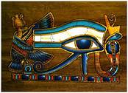
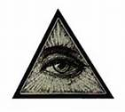
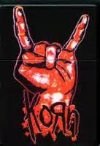
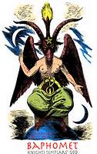
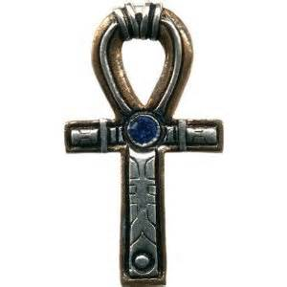
EYE OF HORUS - The falcon-headed god, the kings of Egypt associated themselves with Horus. Horus was among the most important gods of Egypt, particularly because the Pharaoh was supposed to be his earthly embodiment.
ALL SEEING EYE-A universal symbol representing spiritual sight, inner vision, higher knowledge, insight into occult mysteries
The satanic solute an sign of recognition and allegiance between satanists and other unholy groups.
An Egyptian cross symbolizing a mythical eternal life, rebirth, and the life-giving power of the sun.
Baphomet – symbol of the occult, often described as demonic. relating to occultism, ritual magic, witchcraft, Satanism and esoterica. Baphomet often pops up in popular culture to identify anything occult.
Used in occult rituals to direct forces or energies. Often represents satanism, the horned god or various expressions of contemporary occultism, especially when a goat-head is superimposed on the inverted pentagram within a "sacred" circle
Blair Witch - a magic symbol or charm among medieval alchemists and wizards

Slide 5
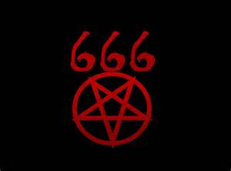
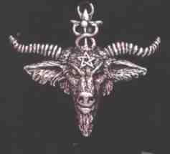
Who’s Behind The Musick
?

Slide 6
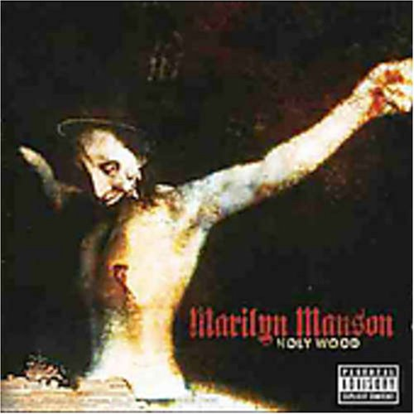
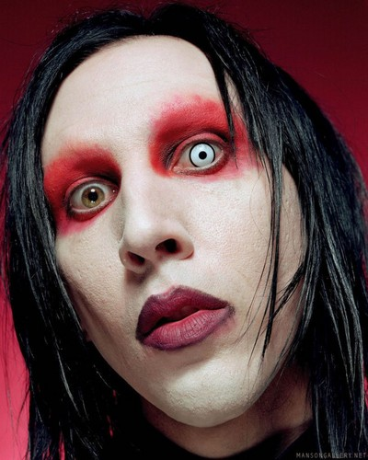
Marilyn Manson “Hopefully, I'll be remembered as the person who brought an end to Christianity.” (Spin, August 1996, p. 34)
DEEPER THAN HELL

Slide 7
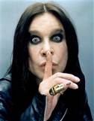
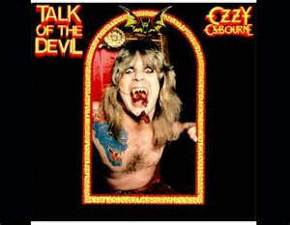
OZZY OSBORNE I really wish I knew why I've done some of the things I've done over the years. I don't know if I'm a medium for some outside source. Whatever it is, frankly, I hope it's not what I think it is — Satan." (Ozzy Osbourne (Hit Parader, Feb., 1978, p.24)

Slide 8
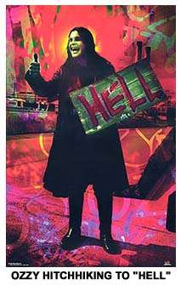
Wine is fine but whiskey's quicker Suicide is slow with liquor Take a bottle, drown your sorrows Then it floods away tomorrows Away tomorrows Evil thoughts and evil doings Cold, alone; you hang in ruins Thought that you'd escape the reaper You can't escape the master keeper 'Cause you feel life's unreal And you're living a lie Such a shame, who's to blame And you're wondering why Then you ask from your cask Is there life after birth What you sow can mean hell on this earth Hell on this earth Now you live inside that bottle The reaper's travelling at full throttle It's catching you but you don't see The reaper's you and the reaper is me Breaking laws, knocking doors But there's no one at home Made your bed, rest your head But you lie there and moan Where to hide, suicide is the only way out Don't you know what it's really about
Suicide Solution

Slide 9
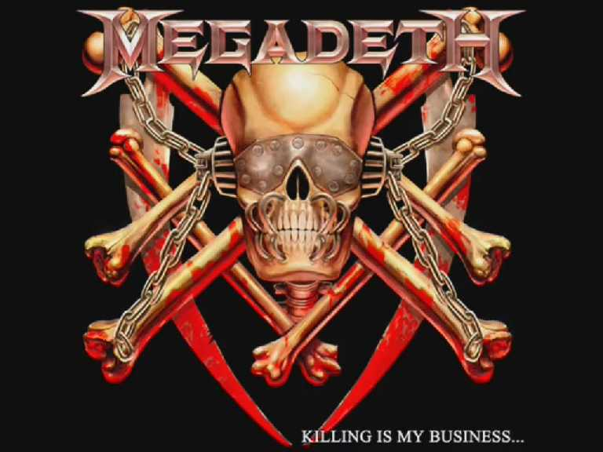
MEGADEATH
GO TO HELL" lyrics by MEGADETH
Now I lay me down to sleep, I pray the lord my soul to keep. If I should die before I wake, I pray the lord my soul to take. I'm not gonna wake up today, They've pulled my plug, the picture fades. And as my body decays, mold begins to fill my grave. The smell of death permeates, The silk within my coffin lays. Go to hell! As they bury me now, six feet there my body lies. Still feel like I can't go down, I hear a distant wailing cry. God, something must've gone wrong. Much too late I realize. Go to hell! I saw my funeral that day, I know who didn't show to mourn. My judgement was life in hell, Pillars of pain and thorns. My only friend's the goat, With 666 between his horns. Go to hell! Place all your trust here in me, Rest assured these things I know. And as Charon sails the sea, Your journey too shall end below. Ah yes you're all sitting ducks, It's true you reap what you sow. Go to hell! Now I lay me down to sleep, Blah, blah, blah my soul to keep. If I die before I wake, I'll go to hell for heaven's sake.

Slide 10
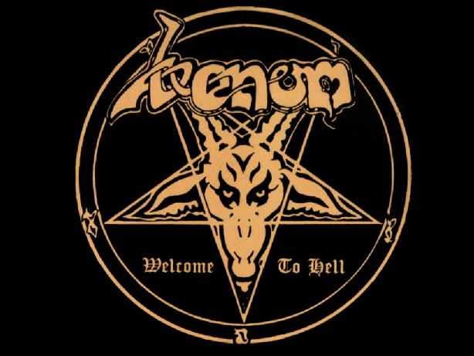
VENOM
Hail Satanas (from VENOM's album, "FALLEN ANGELS," 2011) All hail Satanas – Lucifer He walks among us – Everywhere The fallen angel – Is the light His throne of diamonds – The most high Through the stones of fire Blameless in your ways Sing unholy choir His glorious name – Lucifer/Evil One All hail Satanas – Diabolus He stands beside you – One of us Star of the morning – The son of dawn A realm of sinners – Fires burn Through the stones of fire Blameless in your ways Sing satanic choirs His infernal names – Baphomet/Diabolus Hail Satan Archangel Hail Satan Archangel Commend me father for I have sinned Hail Satan Archangel Hail Satan Archangel Hail Satan Archangel

Slide 11
Ephesians 4:27 Neither give place to the devil.

Slide 12
BUT…I Don’t Listen To Heavy Metal. I Like Hip Hop and POP Music.

Slide 13
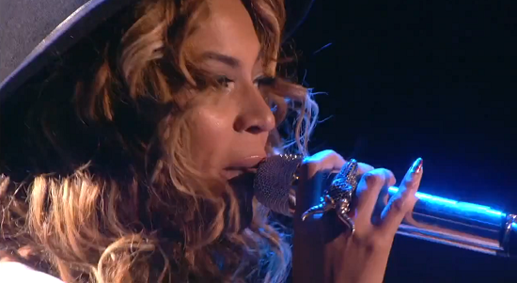
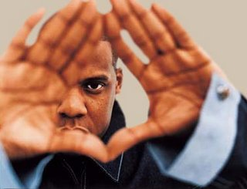
BEYONCE & JAY Z
Sasha Fierce

Slide 14
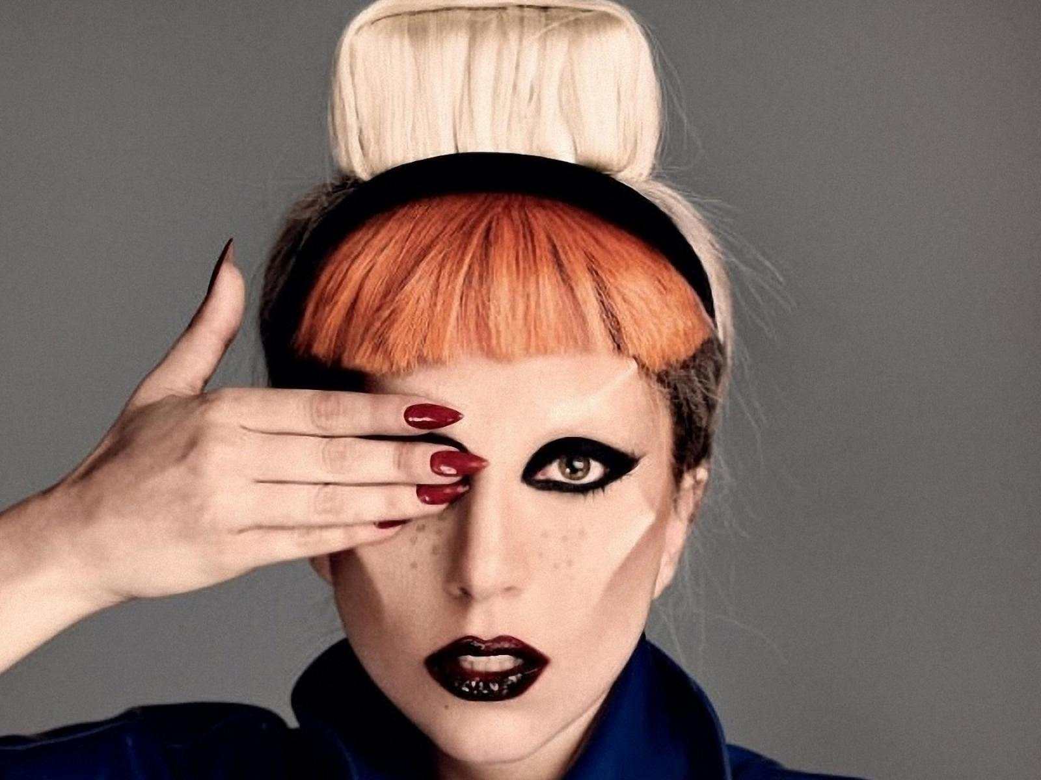
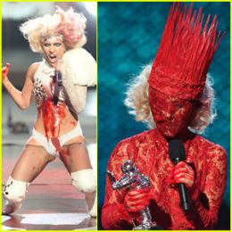
LADY GAGA
paparazzi
“This is for God and the gays’’

Slide 15
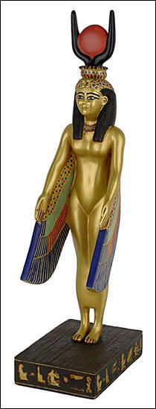
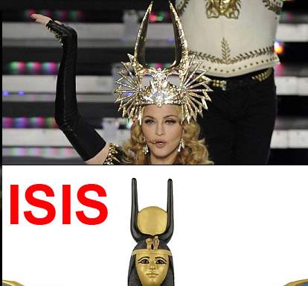
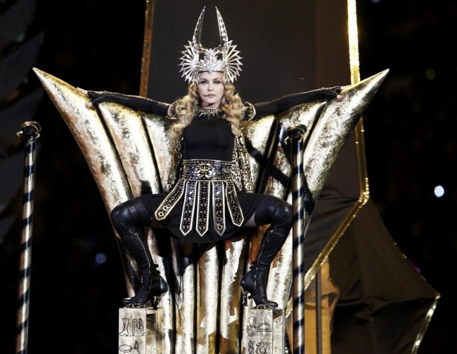
MADONNA
ISIS
“The Superbowl is kind of like the Holy of Holies in America. I’ll come at halfway of the “church experience” and I’m gonna have to deliver a sermon. It’ll have to be very impactful.”

Slide 16
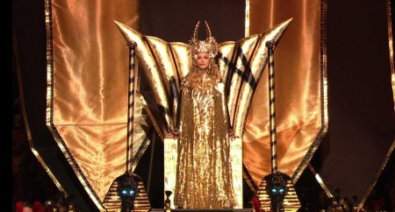
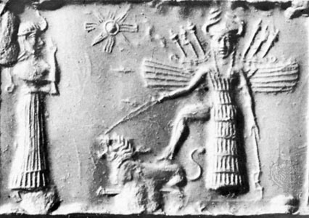
Ishtar

Slide 17
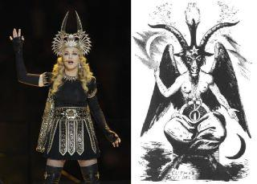
as above, so below

Slide 18
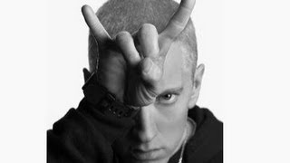
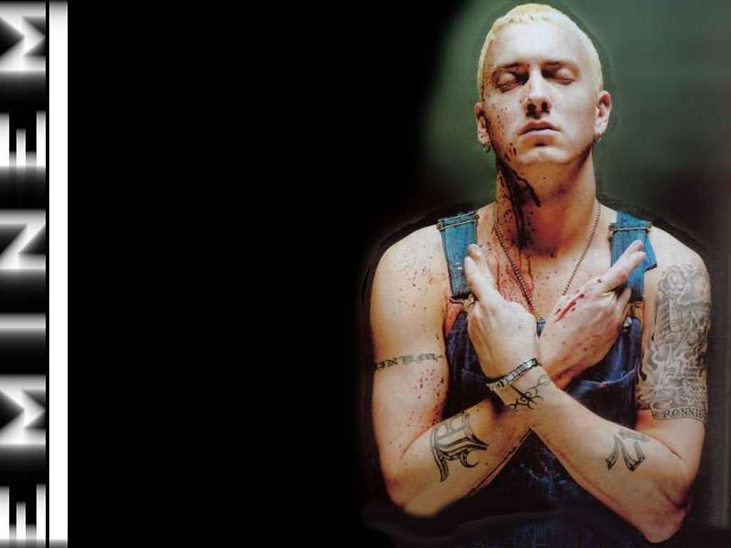
EMINEM

Slide 19
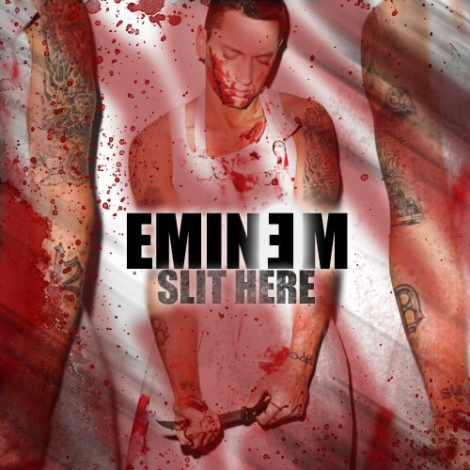
And the dark shall emerge from the fiery depths of hell And swallow the shallow, the hallow who dwell In the shadows of all who are willin' to sell their souls Sometimes I play possom, lt jump from outta nowhere and bite prey And sink my teeth in 'em and fill 'em, fulla poison And make a noise like a snake before I kill 'em
And let 'em know that I just don't feel 'em And smack 'em with the backward E, the Eminem emblem I was taught if you're gonna murder somebody you should face 'em Tell 'em why, look 'em dead in the eye, then waste 'em
And the dark shall emerge from the fiery depths of hell And swallow the shallow, the hallow who dwell In the shadows of all who are willin' to sell their souls For this rap game and it goes
1 2 3 check, check 1 2 3, check, check 1 2 3 That ain't the hook, now follow me There's nothin' else for me to say, my public adores me
and it goes
M
MY DARLING
My Darling

Slide 20
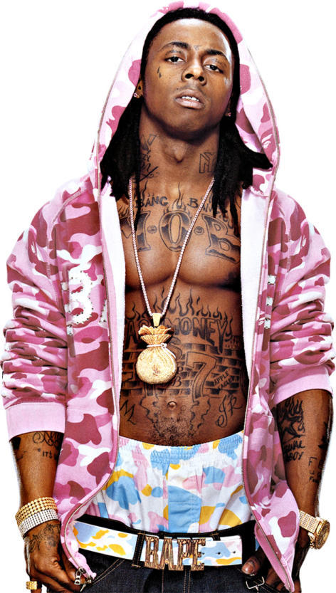
Lil Wayne
LOVE ME LKE SATAN

Slide 21
BEFORE AND AFTER

Slide 22
Ephesians 4:29 Let no corrupt communication proceed out of your mouth, but that which is good to the use of edifying, that it may minister grace unto the hearers.

Slide 23
…But I Don’t Listen To Rock, Rap,or Hip Hop
I like Country

Slide 24
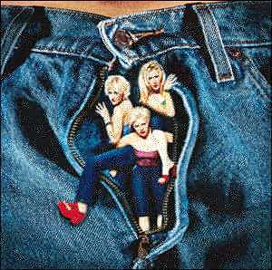
Dixie Chicks
"I love Rachel Maddow. She would be my lesbian girl crush,"
"I'm pro-gay marriage. Pro-gay everything."
Natalie Maines' latest remarks really 'hit home,' so-to-speak, as they came during a visit to her birthplace and hometown as a child, Lubbock, TX. She started her interview with the Lubbock Avalanche-Journal on a good note. But when asked if she was able to attend her childhood church while visiting, an irritated Maines responded...
"No way! I hated how my parents always made me go to that place."
As if that wasn't enough to disturb most local churchgoers, Maines added...
"Besides, now that I'm probably richer than God, maybe he should come to me!"

Slide 25
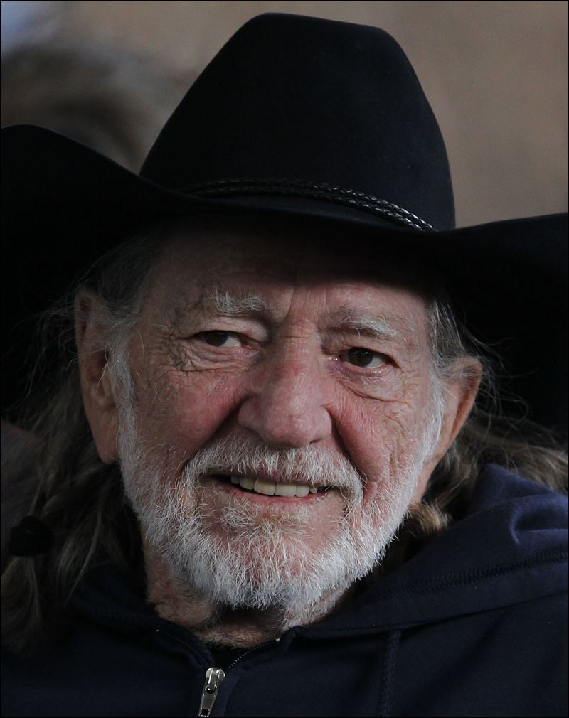
WILLIE NELSON
Cowboys Are Frequently Secretly (Fond of Each Other)
Well, there's many a strange impulse out on the plains of West Texas. There's many a young boy who feels things he can't comprehend. And a small town don't like it when somebody falls between sexes. No, a small town don't like it when a cowboy has feelings for men.
And I believe to my soul that inside every man there's the feminine. And inside every lady there's a deep manly voice loud and clear. Well, a cowboy may brag about things that he's done with his women. But the ones who brag loudest are the ones that are most likely queer.
Cowboys are frequently secretly fond of each other. Say, what do you think all them saddles and boots was about? And there's many a cowboy who don't understand the way that he feels for his brother. And inside every cowboy there's a lady that'd love to slip out.
And there's always somebody who says what the others just whisper. And mostly that someone's the first one to get shot down dead. So when you talk to a cowboy don't treat him like he was a sister. You can't **** with a lady that's sleepin' in each cowboy's head.
Cowboys are frequently secretly fond of each other. What did you think all them saddles and boots was about? And there's many a cowboy who don't understand the way that he feels for his brother. And inside every lady there's a cowboy who wants to come out. And inside every cowboy theirs a lady that’s love to slip out.

Slide 26
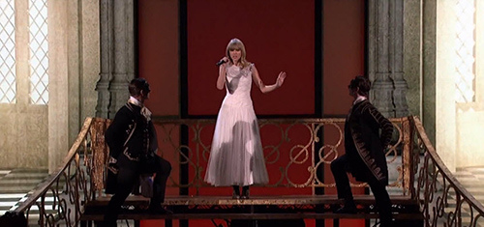
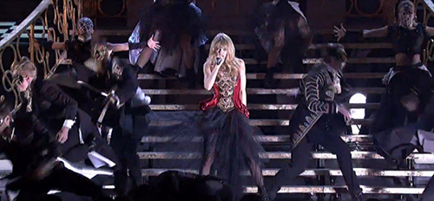
TAYLOR SWIFT
Trouble
Trouble AGAIN

Slide 27
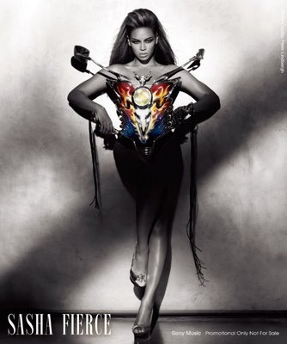

Slide 28
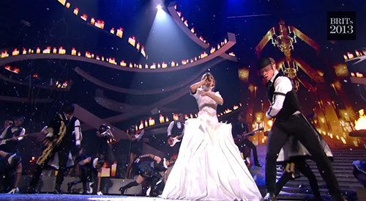
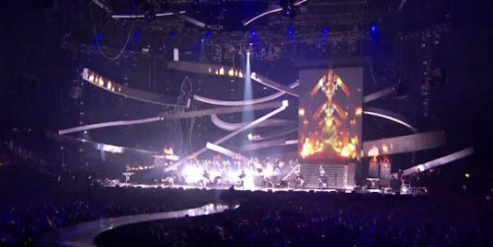
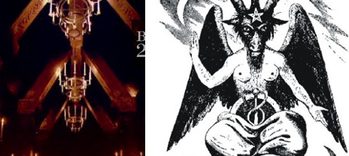

Slide 29
But I Don’t Listen To Country\POP… I Like Christian Rock and Christian Contemporary

Slide 30
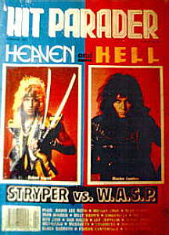
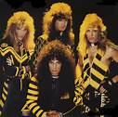
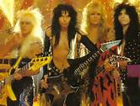
STRYPER
STRYPER
W.A.S.P.
Really
No Difference

Slide 31
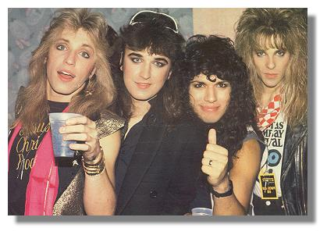
Bass player Steve Gaines says , " . . . we NEVER wanted to get caught up in the whole Christian music scene in the first place. . ." (Inside Music, Oct/Nov 90 p.16) Robert Sweet confesses, " . . . we're about the MOST UNRELIGIOUS Christian band you could imagine. . ."(Hit Parader, Nov. 1986, p.21) And according to lead singer, Michael Sweet, "We don't consider ourselves to be overly religious. . .In fact, religion has NOTHING to do with what Stryper's all about" (Hit Parader, Feb. 1987, p.41)
Stryper guitarist Oz Fox's real name is Richard Martinez. Why does Richard use the name Oz Fox? Because of an obsession with Satanic rocker OZZY OSBOURNE! In fact, on their Reason for the Season album, Stryper's guitarist is listed as "OZZIE" Fox! The name Stryper supposedly comes from Isaiah 53:5 (with his STRIPES we are healed), but in Youth magazine, Stryper guitarist Oz Fox tells the real reason: "One day Robert came up with Stryper because it rhymed with hyper . . ." (Youth, Jan. 1987, p.10) It has nothing to do with Isaiah 53! They admittedly didn't t make the connection to Isaiah 53 till somebody showed them!

Slide 32
Ezekiel 22:26 Her priests have violated my law, and have profaned mine holy things: they have put no difference between the holy and profane, neither have they shewed difference between the unclean and the clean, and have hid their eyes from my sabbaths, and I am profaned among them.

Slide 33
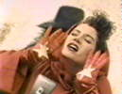
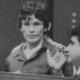
AMY GRANT
.
" After all, Amy confesses, "I'm trying to look SEXY to sell a record . . ." (Rolling Stone, June 6, 1985 p. 10)
Richard Ramirez (The Night Stalker)
Amy Grant

Slide 34
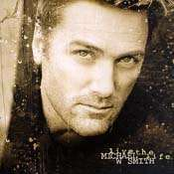
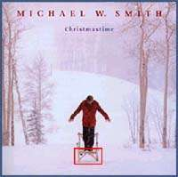
Michael W. Smith
Secret Ambition
If you weren't familiar with Michael W. Smith's standing in the world of contemporary Christian music, you might attend one of his concerts and come out none the wiser." (The Birmingham News, Feb. 12, 1993 p. 5c)
Michael W. Smith's album, Change Your World, has 2819 words — Jesus occurs — ZERO! Michael W. Smith's album, Iï¿½ll Lead You Home, has 2046 words —: Jesus occurs — ZERO

Slide 35
Tiwaz=justice, balance
a god, a sacrifice
mannaz = man ,the self
Runic Letters T and M

Slide 36
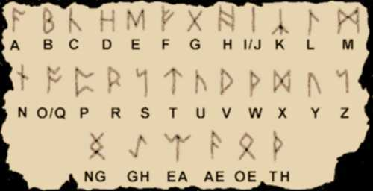
Runic Alphabet
The name rune itself, taken to mean "secret, something hidden", seems to indicate that knowledge of the runes was originally considered esoteric, or restricted to an elite.

Slide 37
Magick in Theory and Practice, for the occultist, ". . . let him learn to write backwards. . ."
". . .train himself to think BACKWARDS by external means, as set forth here following. (a) Let him learn to write BACKWARDS. . . (b) Let him learn to walk BACKWARDS. . . (c) Let him. . . listen to phonograph records REVERSED (d) Let him practice speaking BACKWARDS. . . (e) Let him learn to read BACKWARDS. . ." (Crowley, Aleister. Magick: Liber ABA, book four, 1994 Ordo Templi Orientis ediiton, p. 639)
Michael W. Smith Spelled backwards on his album THE BIG PICTURE

Slide 38
1Thessalonians 5:22 Abstain from all appearance of evil.

Slide 39
Born Again Lesbian Music
Stevens became the first (and as of 2002, the only) major singer in the contemporary Christian music subculture to identify herself publicly as a lesbian…Christian Century Magazine has said that Stevens became "conservative Christianity's worst nightmare - a Jesus-loving, Bible-believing, God-fearing lesbian Christian."
Today, Marsha and her spouse, Cindy, are working between tours to continue their music ministry training school for those in Christian outreach to the GLBT community. An outreach of Balm Ministries (Born Again Lesbian Music), the program is called upBeat!. They have produced a Praise and Worship album with 14 singers and 10 songwriters and each year they accept 6 to 10 students into their training seminars. The next training will be held at King of Peace MCC in St. Petersburg, FL in June of 2006.

Slide 40
Leviticus 18:22 Thou shalt not lie with mankind, as with womankind: it is abomination.
Leviticus 20:13 If a man also lie with mankind, as he lieth with a woman, both of them have committed an abomination: they shall surely be put to death; their blood shall be upon them.

Slide 41
The Purpose Of Christian Music
Psalms 9:2 I will be glad and rejoice in thee: I will sing praise to thy name, O thou most High.
Psalms 21:13 Be thou exalted, LORD, in thine own strength: so will we sing and praise thy power.
Psalms 28:7 The LORD is my strength and my shield; my heart trusted in him, and I am helped: therefore my heart greatly rejoiceth; and with my song will I praise him.
Acts 16:25 And at midnight Paul and Silas prayed, and sang praises unto God: and the prisoners heard them.

Slide 42
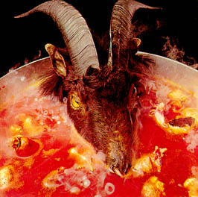
‘Sympathy For The Devil’
Signs and Symbols
‘Sympathy
Please allow me to introduce myself I'm a man of wealth and taste I've been around for a long, long year Stole many a man's soul and fate
I was 'round when Jesus Christ Had his moments of doubt and pain Made damn sure that Pilate Washed his hands and sealed his fate
Pleased to meet you Hope you guess my name, oh yeah But what's puzzling you Is the nature of my game
I stuck around St. Petersburg When I saw it was a time for a change Killed the Tzar and his ministers Anastasia screamed in vain
I rode a tank Held a General's rank When the Blitzkrieg raged And the bodies stank
Pleased to meet you Hope you guess my name, oh yeah What's puzzling you Is the nature of my game, oh yeah
I watched the glee While your kings and queens Fought for ten decades For the Gods they made
I shouted out "Who killed the Kennedys?" Well after all It was you and me
Let me please introduce myself I'm a man of wealth and taste And I laid traps for troubadours Who get killed before they reached Bombay
Killed the Tst
nPleased to meet you Hope you guess my name, oh yeah But what's puzzling you Is the nature of my game, oh yeah
Pleased to meet you Hope you guess my name, oh yeah But what's confusing you Is just the nature of my game, ooh yeah
Just as every cop is a criminal And all the sinners saints As heads is tails just call me Lucifer I'm in need of some restraint
So if you meet me, have some courtesy Have some sympathy and some taste Use all your well learned politics Or I'll lay your soul to waste, mmm yeah
Pleased to meet you Hope you guess my name, mmm yeah But what's puzzling you Is the nature of my game, get down Woo hoo, ah yeah, get on down, oh yeah
Tell me, baby, what's my name? Tell me, honey, baby guess my name Tell me, baby, what's my name? I'll ya one time you're to blame
What's my name? Tell me, baby, what's my name? Tell me, sweetie, what's my name?
you meet me, have some courtesy Have some sympathy and some taste Use all your well learned polihat's my name?
Rolling Stones ‘Goat Head Soup Album’
(inner sleeve)

Slide 43
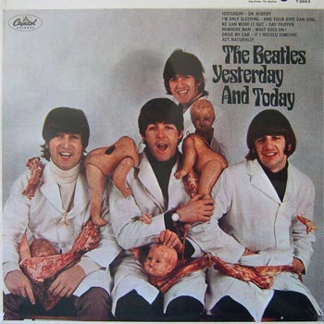

Slide 44
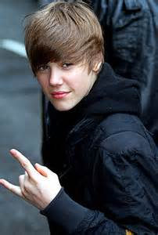
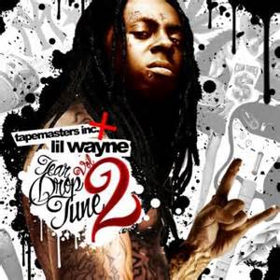
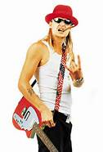

Slide 45
666

Slide 46
666
Aleister Crowley
Anton LeVay
They Sold Their Soul For Rock and Roll

Slide 47
Daniel 3:5 That at what time ye hear the sound of the cornet, flute, harp, sackbut, psaltery, dulcimer, and all kinds of musick, ye fall down and worship the golden image that Nebuchadnezzar the king hath set up:
Cornets, Flutes and Harps
And ALL KINDS OF MUSIC
Daniel 3:7 Therefore at that time, when all the people heard the sound of the cornet, flute, harp, sackbut, psaltery, and all kinds of musick, all the people, the nations, and the languages, fell down and worshipped the golden image that Nebuchadnezzar the king had set up.

Slide 48
1972 Rothschild Ball
The wealth of the Rothschild family at its height during the mid-19th century has been estimated in today's terms in the hundreds of billions or even in the trillions of dollars. Starting as a small local banking operation, the Rothschild rise to fortune came from loaning European governments money during the Napoleonic wars. Although their wealth today is never publicly acknowledged, the Rothschilds are known to have significant stakes in the central banks of several countries. ⁻ Wikipedia

Slide 49
Rothschild’s Mansion The Château de Ferrières

Slide 50
A guest wearing multiple-faced mask. A similar mask is seen in Eyes Wide Shut (was the movie inspired by Rothschild balls?). Did this ball “devolve” into the debauchery depicted in the movie?

Slide 53
The host is wearing a giant horned head. How appropriate.

Slide 61
1 Th5:5 Ye are all the children of light, and the children of the day: we are not of the night, nor of darkness.
1Th 5:6 Therefore let us not sleep, as do others; but let us watch and be sober.
1Th 5:7 For they that sleep sleep in the night; and they that be drunken are drunken in the night.
1Th 5:8 But let us, who are of the day, be sober, putting on the breastplate of faith and love; and for an helmet, the hope of salvation.

Slide 62
Phillipians 4:8 Finally, brethren, whatsoever things are true, whatsoever things are honest, whatsoever things are just, whatsoever things are pure, whatsoever things are lovely, whatsoever things are of good report; if there be any virtue, and if there be any praise, think on these things.

Slide 63
Galatians 6:7 Be not deceived; God is not mocked: for whatsoever a man soweth, that shall he also reap.

Slide 64
SATANS GREATEST WEAPON IS OUR OWN IGNORANCE

Slide 65
HOSEA 4:6 My people are destroyed for lack of knowledge: because thou hast rejected knowledge, I will also reject thee,

Slide 66
EPILOGUE
Katy Perry\Juicy J Performance at 2014 Grammys
Want To Play With Magic

Slide 67
AMEN

